Slide 1
CS405 Week 1
Introduction; Image Formats; Raster vs Vector
Prof. Dr. Selim Balcısoy
Sabancı University
Notes:
Introduce course CS405 and explain how computer graphics spans both scientific and artistic domains.

Slide 2
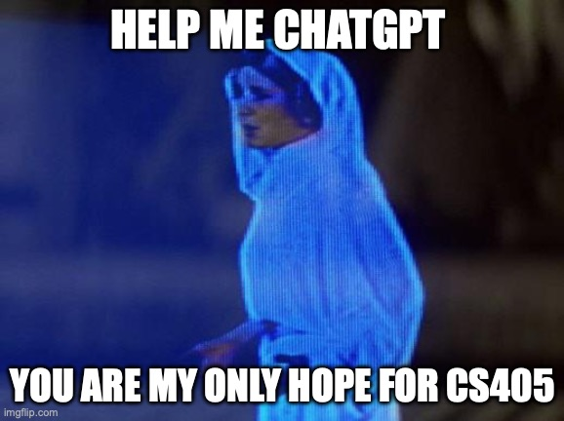
Welcome & Title
Welcome to CS405! This course explores the fundamentals of computer graphics, blending science, art, and technology.
We'll cover how computers create, manipulate, and render images—from basic pixels to advanced 3D scenes.
Why graphics? It's everywhere: video games, movies, scientific visualizations, VR/AR, and even AI-generated art.
Today's focus: Introduction to the course and the basics of images (raster vs. vector).
Notes:
Provide instructor contact details, office hours, and emphasize communication via email and course platform.

Slide 3
Instructor Info
Lead Instructor: Prof. Dr. Selim Balcısoy (balcisoy@sabanciuniv.edu)
Office: FENS Building, Room 1096 | Office Hours: Mondays 10:30-11:30 PM (or by appointment)
Teaching Assistant: Doruk Benli (dorukbenli@sabanciuniv.edu)
Communication: Use email for questions; SuCourse for announcements, assignments, and forums.
Tip: Always include "CS405" in email subjects for faster responses.
Notes:
Outline main objectives: understanding image formation, rendering, modeling, and interactive applications.

Slide 4
Course Objectives
Understand the foundations of image formation, processing, and rendering.
Master geometric modeling, transformations, and interactive 3D applications.
Explore connections between graphics and art, inspired by the Sakıp Sabancı Museum collection.
Build practical skills in WebGL/WebGPU, shaders, and tools like Three.js and Blender.
Prepare for real-world applications in gaming, film, visualization, and emerging tech like AI art.
Notes:
List expected learning outcomes: implementing shaders, transformations, real-time rendering, NPR, and PBR.

Slide 5
Learning Outcomes
Implement shaders for non-photorealistic (NPR) and physically based rendering (PBR).
Apply transformations, curves, and meshes to model 3D scenes.
Extract geometry from images (e.g., lines, splines) and handle real-time rendering.
Use asset pipelines (glTF) for importing models and creating animations.
Develop interactive graphics apps, evaluating algorithms like ray tracing and anti-aliasing.
Bonus: Appreciate graphics in art through SSM paintings analysis.
Notes:
Show the weekly breakdown of topics and integration with Sakıp Sabancı Museum artworks.

Slide 6
Course Structure
Weekly topics, projects, integration with art.
Weekly Topics: From basics (Week 1: Images) to advanced (Week 14: WebGPU & Animations).
Integration with Art: Each week ties to an SSM painting
Projects: 3 hands-on assignments released in Weeks 3, 7, 11.
Exams: Midterm (Week 7, tentative), Final
Notes:
Explain grading policy: emphasize project-based learning and participation.

Slide 7
Grading Policy
Projects: 60% (Hands-on, individual; Focus on creativity, code quality).
Midterm: 15% (Theory + practical questions).
Final: 25% (Comprehensive exam).
Attendance: Monitored; Impacts final letter grade.
Projects are your chance to shine—start early!
Notes:
Preview the three major projects and their relation to weekly lectures.

Slide 8
Projects Overview
Project 1 (Weeks 3-6): Geometry extraction from paintings (e.g., Hough lines, Bézier curves).
Project 2 (Weeks 7-9): NPR shaders inspired by art (toon, hatching).
Project 3 (Weeks 11-14): PBR scene reconstruction with Blender/glTF.
All tie to SSM artworks;
Tips: Start early, use provided resources, cite AI if used.
Notes:
Introduce required textbooks and explain how each complements the course.

Slide 9
Required Textbooks
"Fundamentals of Computer Graphics" by Peter Shirley & Steve Marschner (4th Ed.)—Core theory on rendering and modeling.
"Real-Time Rendering" by Tomas Akenine-Möller et al. (4th Ed.)—In-depth on pipelines and shaders.
"Ray Tracing in One Weekend" by Peter Shirley (Free online)—Quick intro to ray tracing.
Notes:
Present online resources including WebGL Fundamentals, Three.js, and Blender documentation.

Slide 10
Online Resources
WebGL Fundamentals: https://webglfundamentals.org/ (Core concepts, tutorials).
WebGPU Specification: https://gpuweb.github.io/gpuweb/ (Next-gen graphics API).
Three.js Documentation: https://threejs.org/docs/ (High-level 3D library).
Blender Official: https://www.blender.org/ (3D modeling/animation).
glTF 2.0 Overview: https://www.khronos.org/gltf/ (Model format).
GitHub Student Pack: https://education.github.com/pack (Free tools).
Notes:
Discuss software setup: VS Code, Node.js, browser requirements, and Blender for modeling.

Slide 11
Tools Setup
Required Tools:
VS Code: Code editor for JavaScript, GLSL/WGSL.
Node.js: For running local servers (WebGL projects).
Browsers: Chrome/Firefox (WebGL/WebGPU support).
Blender: Free 3D modeling/animation software.
GitHub: Version control for project submissions.
- Setup Steps:
Install via GitHub Student Pack (free).
Test WebGL: https://get.webgl.org/.
Blender tutorials on SuCourse.
Tip: Set up by Week 2 for labs!
Notes:
Explain academic integrity rules, acceptable collaboration, and correct use of AI/LLMs.

Slide 12
Academic Integrity
Rules:
Plagiarism is strictly prohibited—submit your own work.
AI/LLM Use: Permitted only with instructor approval; Cite usage in submissions.
Consequences: Violations may lead to grade penalties or course failure.
Tip: When in doubt, ask instructors or cite sources!
Notes:
Answer the question: why study graphics? Applications include entertainment, science, and AI art.

Slide 13
Why Study Graphics?
Applications:
Entertainment: Video games (e.g., Unreal Engine), films (Pixar).
Science: Data visualization, medical imaging.
Emerging Tech: VR/AR, AI art (e.g., Stable Diffusion).
Impact: Graphics drives innovation across industries.
SSM Connection: Analyze art to understand rendering techniques.
Fun Fact: Graphics powers 90% of modern media!
Notes:
Provide historical perspective from early research (Sketchpad) to GPUs and Pixar innovations.

Slide 14
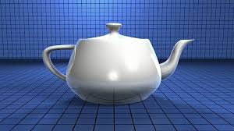
Historical Context
Milestones:
1963: Sketchpad (Ivan Sutherland)—First interactive graphics system.
1970s: Utah Teapot—Iconic 3D model for testing.
1980s: Pixar’s RenderMan—Revolutionized film rendering.
1990s-Present: NVIDIA GPUs—Enabled real-time graphics.
Impact: From research labs to everyday devices. https://www.nvidia.com/en-us/about-nvidia/corporate-timeline/
https://www.youtube.com/watch?v=NXkkr0REEPI
https://www.youtube.com/watch?v=RNvYGcgoGcs
https://www.apple.com/apple-vision-pro/
https://youtu.be/mpKKcqWnTus?si=sTT5SGdUPyaz8piR
Notes:
Show cutting-edge developments like ray tracing hardware and neural rendering models.

Slide 15
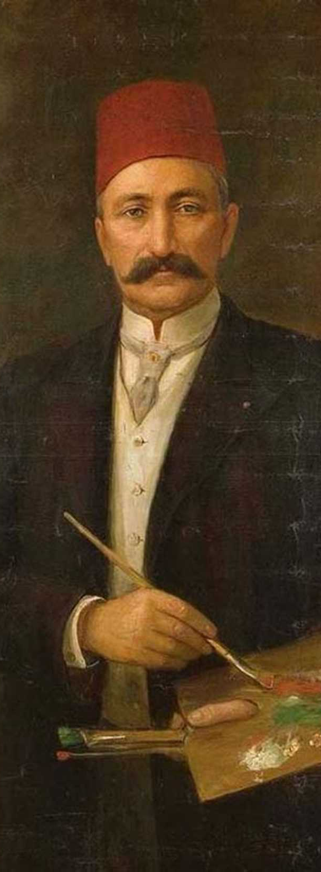
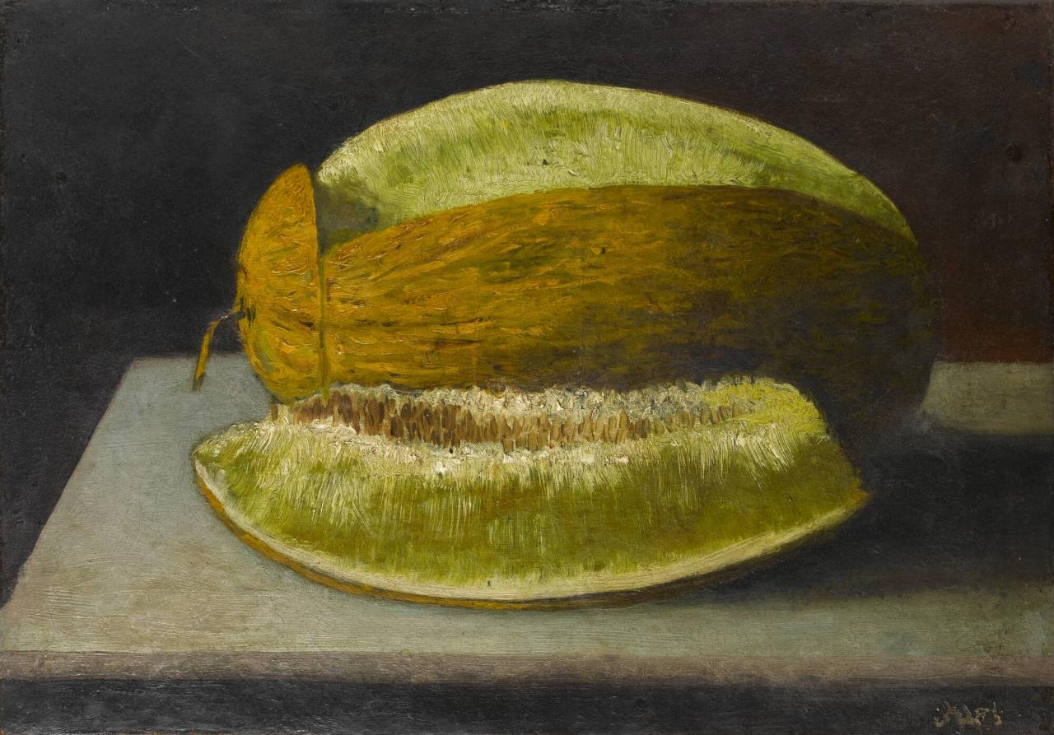
Painter of the Week: Şeker Ahmet Paşa
Biography
Born in Üsküdar, Istanbul.
Originally studied medicine at the Imperial School of Medicine, but his talent in drawing was quickly noticed.
Sent by Sultan Abdülaziz to Paris in 1860s, where he studied at the École des Beaux-Arts under well-known French artists like Gustave Boulanger and Jean-Léon Gérôme.
After returning to Istanbul, he served both as a military officer and as a court painter. He later became a Pasha (general).
Artistic Contributions
Introduced Western-style realism into Ottoman painting.
Specialized in still lifes (especially fruit arrangements like Kavunlu Natürmort, with melons and grapes) and landscapes.
Considered the pioneer of Ottoman still life painting, moving away from purely decorative or miniature traditions.
Organized one of the first public art exhibitions in Istanbul in 1873, which helped spread Western-style art in the Ottoman Empire.
Legacy
Remembered as a bridge figure who brought European academic realism into Ottoman art.
The nickname “Şeker” comes from his sweet and gentle personality.
Notes:
Show cutting-edge developments like ray tracing hardware and neural rendering models.

Slide 16
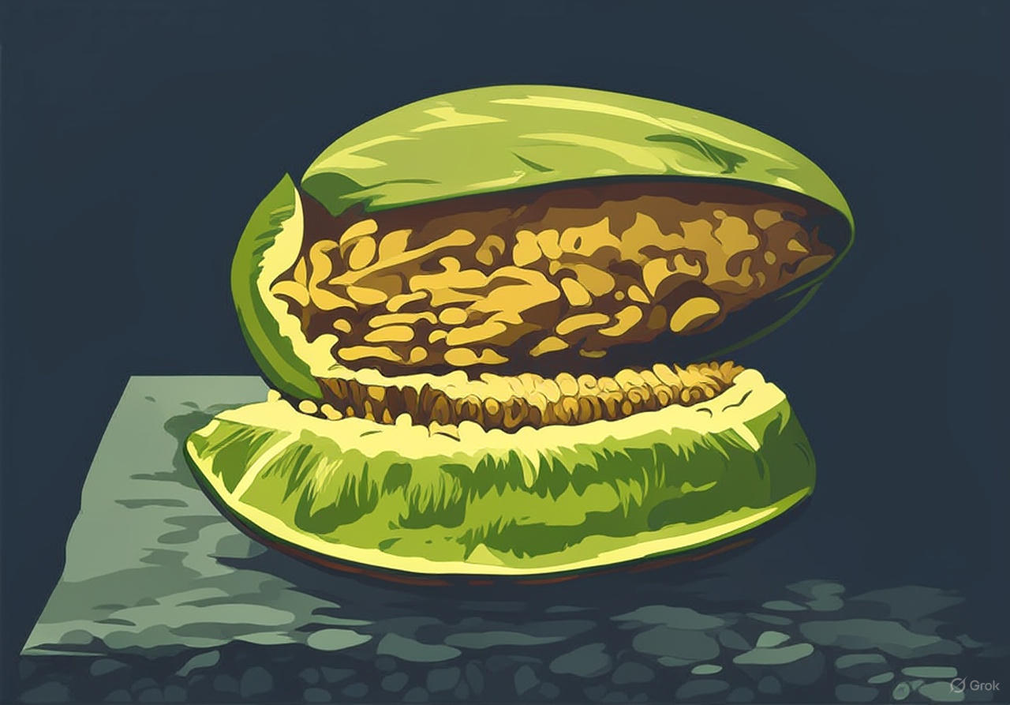
Art Connection
Focus: Still-life painting of fruits (1870s).
Graphics Link:
Raster: Captures textures (e.g., melon’s surface).
Vector: Outlines shapes (e.g., fruit contours).
Why It Matters: Art inspires algorithms for rendering and geometry extraction.
Activity: Compare how raster/vector represent this painting.
Tip: Project 1 uses similar analysis!
Notes:
Define what constitutes an image in computer graphics: discrete samples of light.

Slide 17
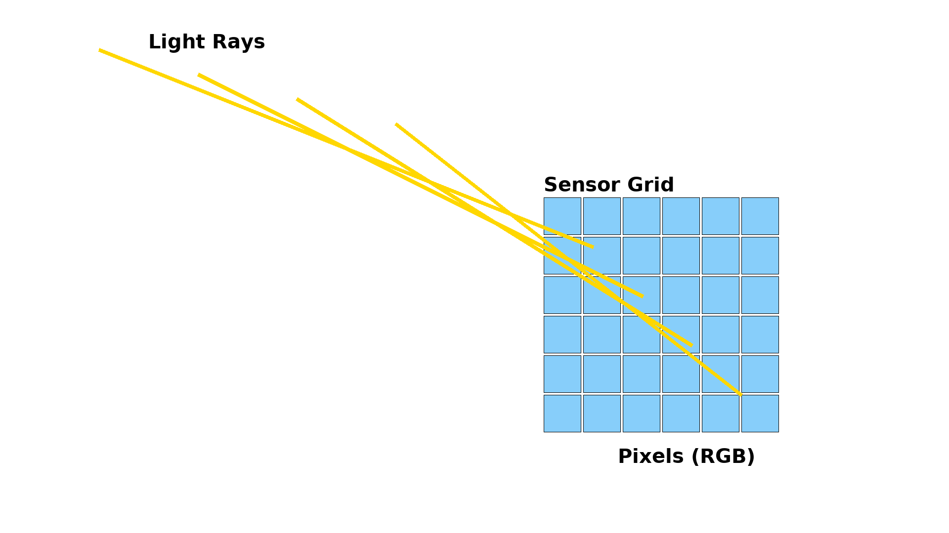
What is an Image?
Definition: Discrete samples of light and color.
Components:
Pixels (raster) or mathematical primitives (vector).
Stores RGB, intensity, or other data.
Graphics Role: Images are the foundation of rendering.
Key Takeaway: Images are data we manipulate!
Notes:
Introduce raster images as a matrix of pixels storing discrete values.

Slide 18
Raster Images
Definition: Grid of pixels storing RGB values.
Properties:
Fixed resolution (e.g., 1920x1080).
Pixelation when zoomed.
Examples: Photos, digital paintings.
Key Takeaway: Raster = discrete pixel grid.
Notes:
Show PNG and JPEG examples, explaining zoom-in artifacts like pixelation.

Slide 19
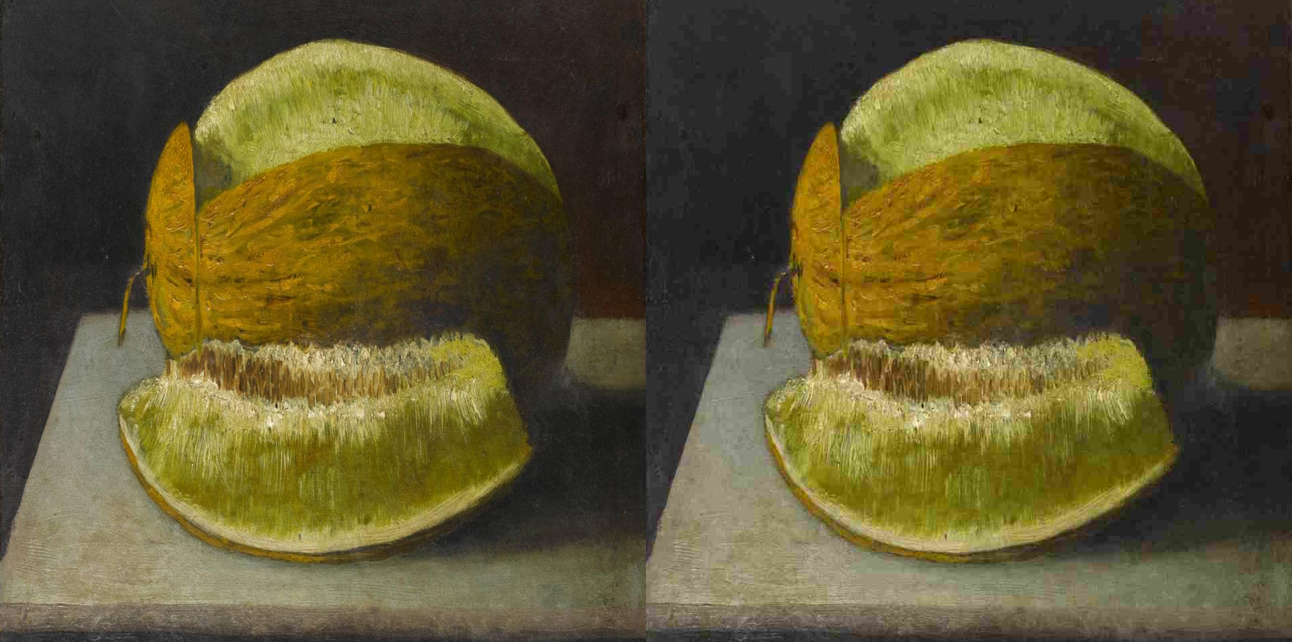
Raster Examples
PNG:
Lossless compression, supports transparency.
Ideal for sharp edges, text, logos.
JPEG:
Lossy compression, smaller file sizes.
Shows artifacts when zoomed (pixelation, blocks).
Key Takeaway: Format choice impacts quality!
Notes:
Define vector images: mathematical representations of shapes, curves, and lines.

Slide 20
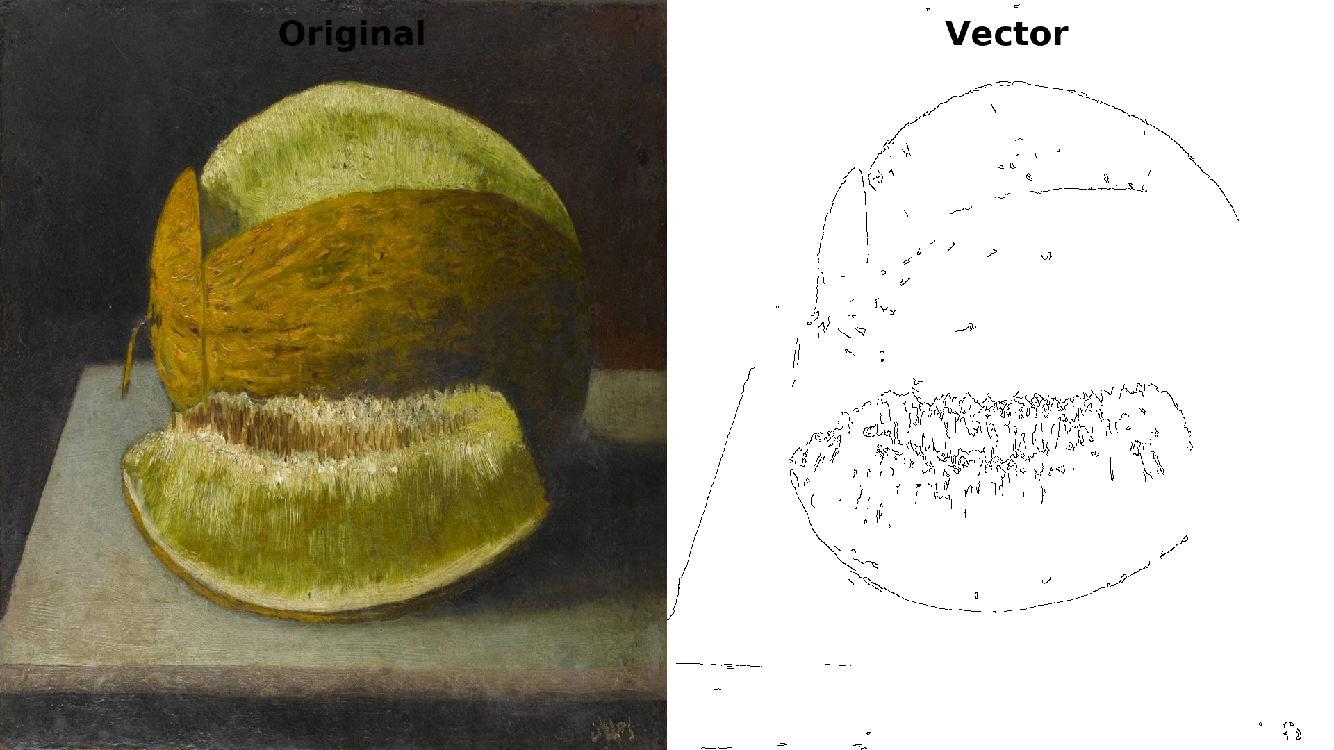
Vector Images
Definition: Mathematical shapes (lines, curves, polygons).
Properties:
Scalable without loss (no pixelation).
Smaller file size for simple graphics.
Examples: Logos, icons, SVG files.
Key Takeaway: Vector = scalable precision.
Notes:
Provide an SVG snippet demonstrating scalable circle rendering.

Slide 21
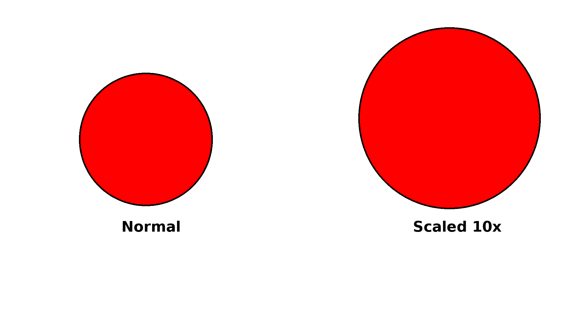
Vector Examples
SVG (Scalable Vector Graphics):
XML-based format for shapes.
Example: `<circle cx="50" cy="50" r="40" fill="red"/>`.
Advantages:
Scales without quality loss.
Editable via code or tools (e.g., Inkscape).
Demo: Render a circle, scale it up—no pixelation!
Notes:
Directly compare raster and vector: resolution dependence, memory needs, editability.

Slide 22
Raster vs Vector Comparison
Comparison Table:
| Aspect | Raster | Vector |
|--------|--------|--------|
| Storage | Pixel grid (RGB) | Math shapes |
| Scalability | Pixelates when zoomed | Scales perfectly |
| File Size | Large for high-res | Small for simple shapes |
| Use Cases | Photos, textures | Logos, diagrams |
Key Takeaway: Choose based on task!
Notes:
Explain resolution, pixels, and relationship to device DPI and PPI.

Slide 23
Pixels & Resolution
Pixel: Smallest addressable element (stores RGB).
Resolution: Width × Height (e.g., 1920x1080 pixels).
Device Metrics:
DPI: Dots per inch (printing).
PPI: Pixels per inch (screens).
Impact: Higher resolution = sharper image, larger file.
Notes:
Discuss bit depth and how it affects the number of displayable colors.

Slide 24
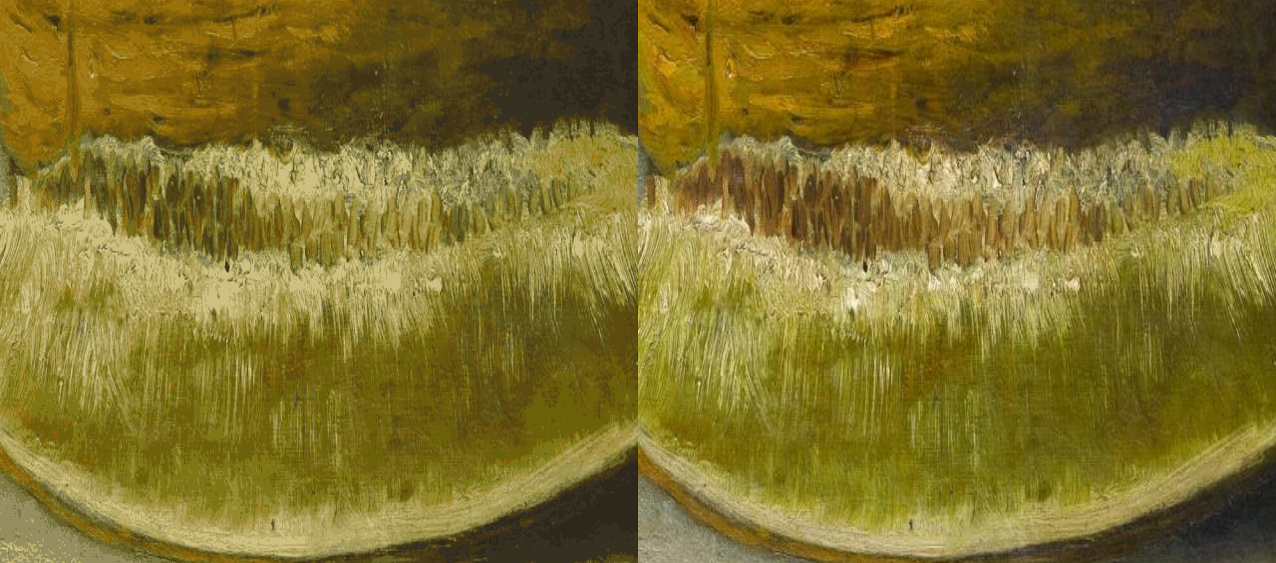
Bit Depth
Definition: Bits per pixel/channel, determines color range.
Examples:
8-bit: 256 colors/channel (16.7M total).
16-bit: 65,536 colors/channel (HDR).
32-bit float: High dynamic range (film, games).
Impact: Higher bit depth = richer colors, larger files.
Notes:
Explain RGB, CMYK, HSV, and formula for luminance conversion.

Slide 25
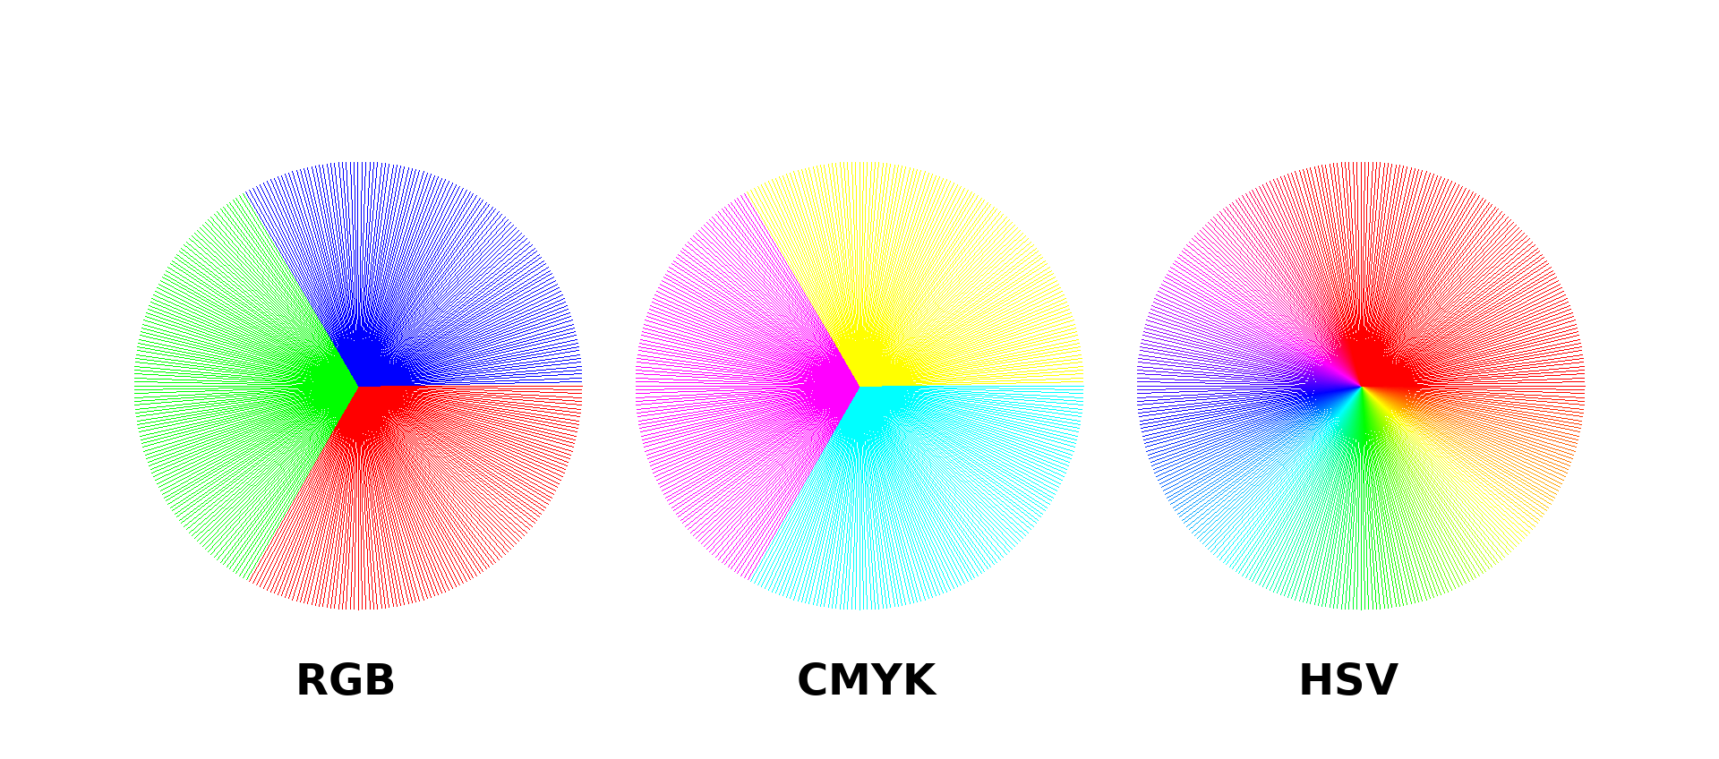
Color Models
Common Models:
RGB: Additive (screens), R+G+B = White.
CMYK: Subtractive (printing), C+M+Y+K = Black.
HSV: Hue, Saturation, Value (intuitive editing).
Luminance Formula: Y = 0.299R + 0.587G + 0.114B.
Use Case: RGB for digital, CMYK for print.
Notes:
Explain gamma correction and why it aligns digital values with human perception.

Slide 26
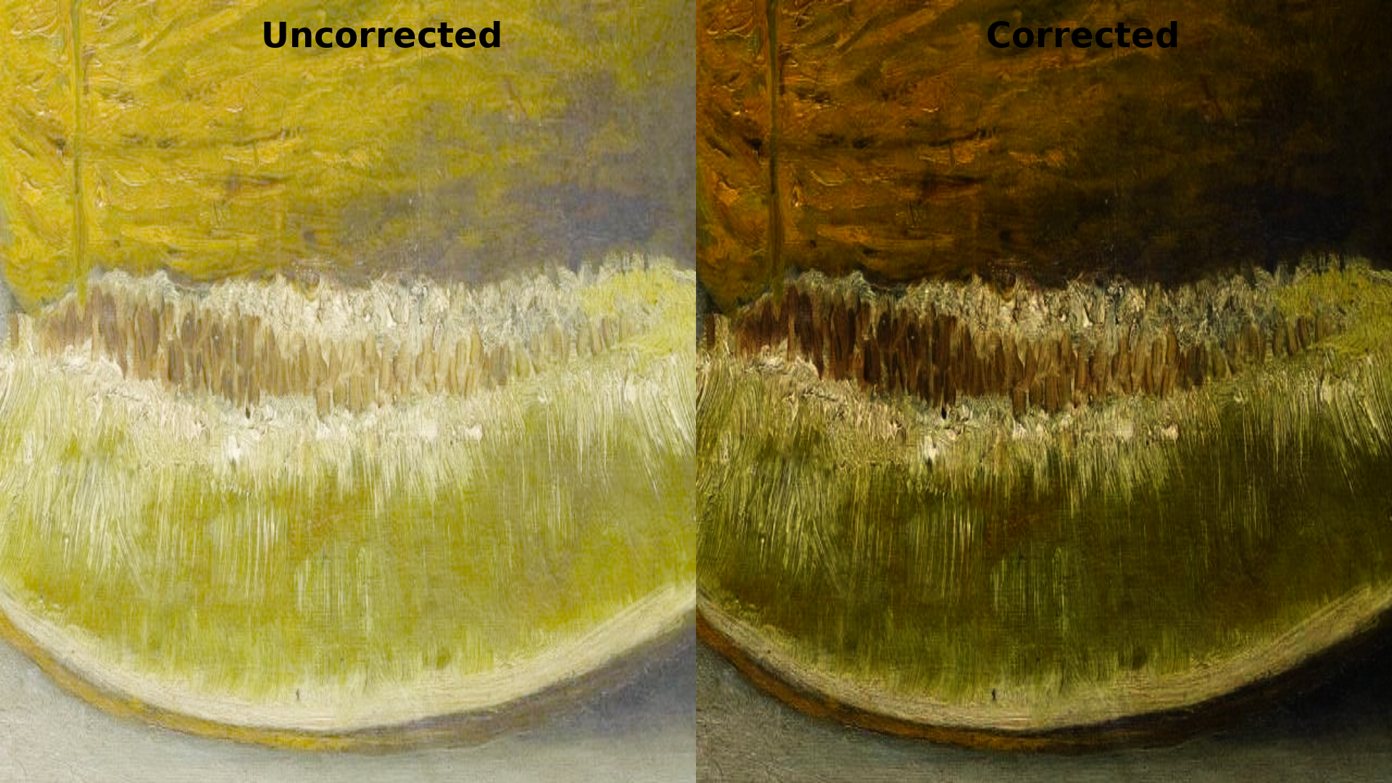
Gamma Correction
Purpose: Aligns digital values with human perception.
Formula: V_out = V_in^(1/2.2) (sRGB standard).
Why?: Human eyes perceive light non-linearly.
Impact: Ensures accurate color display on screens.
Notes:
Discuss different color spaces and their uses in HDR and wide gamut displays.

Slide 27
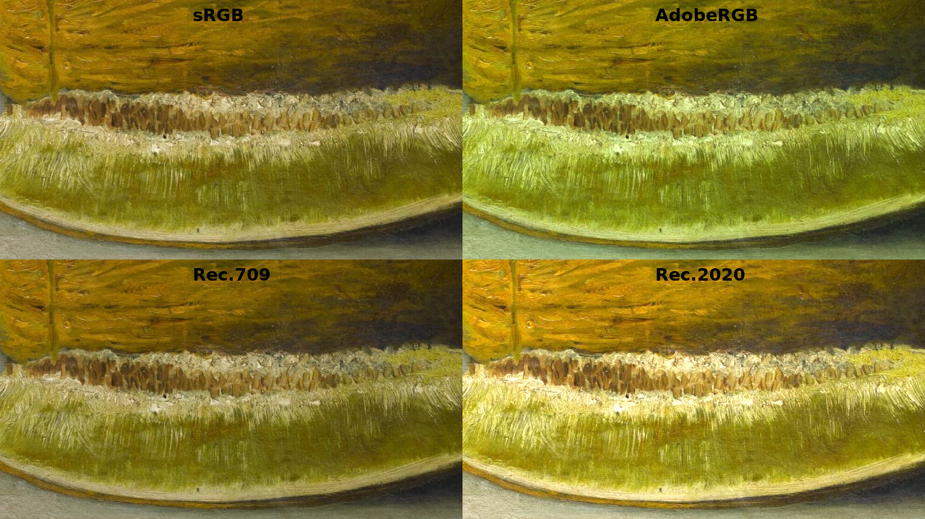
Color Spaces
Definition: Systems for representing colors (e.g., sRGB, AdobeRGB).
Common Spaces:
sRGB: Standard for web/screens.
AdobeRGB: Wider gamut for professional displays.
Rec.709/Rec.2020: Video/HDR standards.
Use Case: Rec.2020 for HDR in films.
Notes:
Introduce sampling theorem and importance of oversampling to avoid loss of information.

Slide 28
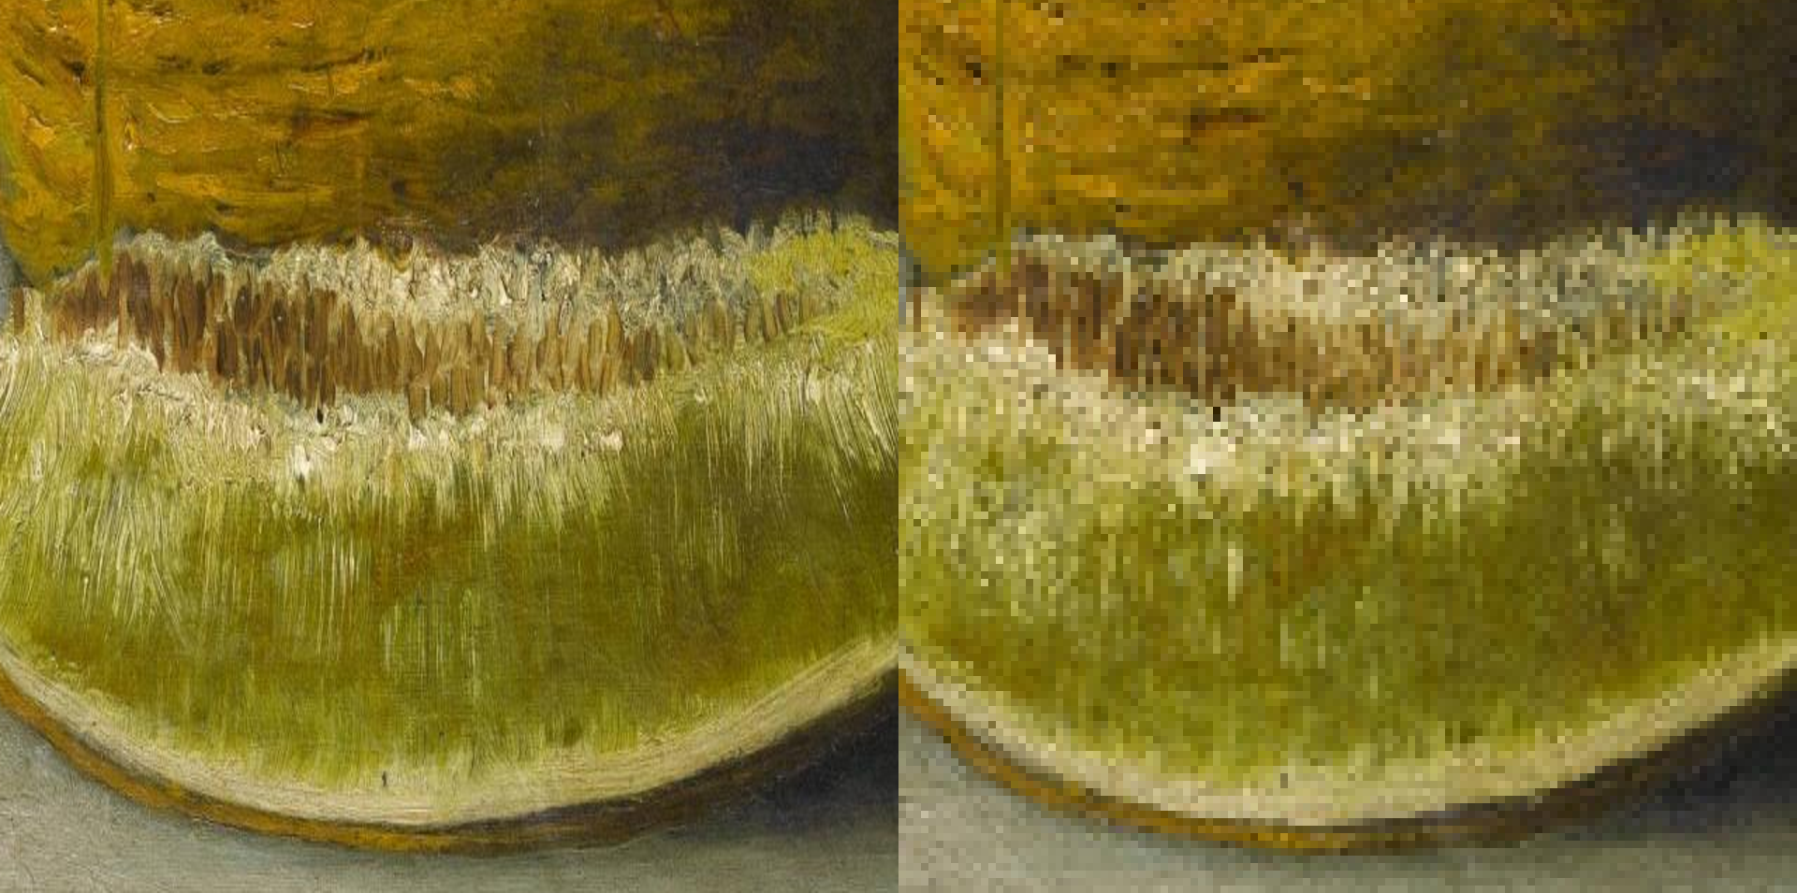
Image Sampling
Definition: Capturing light at discrete points (pixels).
Nyquist Theorem: Sample at 2x highest frequency to avoid aliasing.
Importance: Oversampling prevents information loss.
Key Takeaway: Sampling drives image quality.
Notes:
Show aliasing artifacts when undersampling high-frequency content.

Slide 29
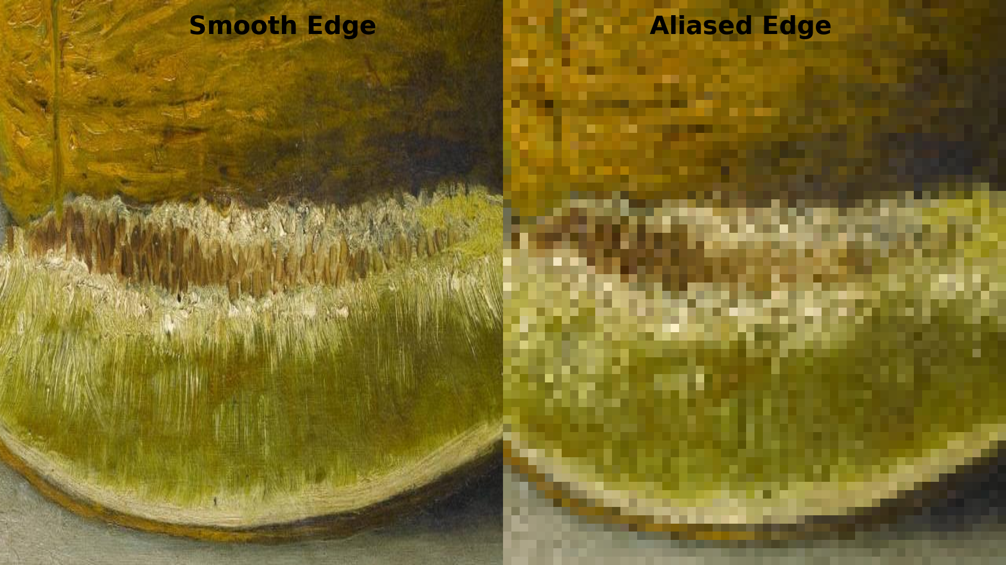
Aliasing
Definition: Artifacts from undersampling high-frequency content.
Visual Effect: Jagged edges (“jaggies”) in images.
Cause: Sampling below Nyquist rate.
Solution: Anti-aliasing techniques (next slide!).
Notes:
Discuss anti-aliasing strategies like supersampling and filtering.

Slide 30
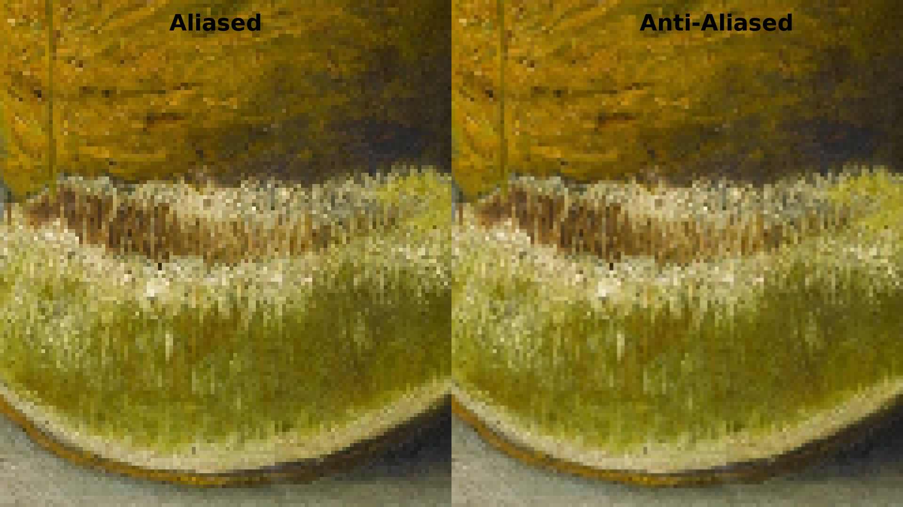
Anti-Aliasing
Definition: Techniques to reduce aliasing artifacts.
Methods:
Supersampling: Sample at higher resolution, then average.
Filtering: Smooth edges with algorithms (e.g., MSAA).
Impact: Improves visual quality, increases computation.
Notes:
Illustrate zoom differences between raster pixelation and vector scalability.

Slide 31
Zoom Example
Raster:
Pixelates when zoomed (e.g., Kavunlu Natürmort details blur).
Fixed resolution limits scalability.
Vector:
Stays crisp at any zoom (e.g., fruit outlines).
Mathematical shapes scale infinitely.
Notes:
Introduce image compression: lossy vs lossless trade-offs.

Slide 32
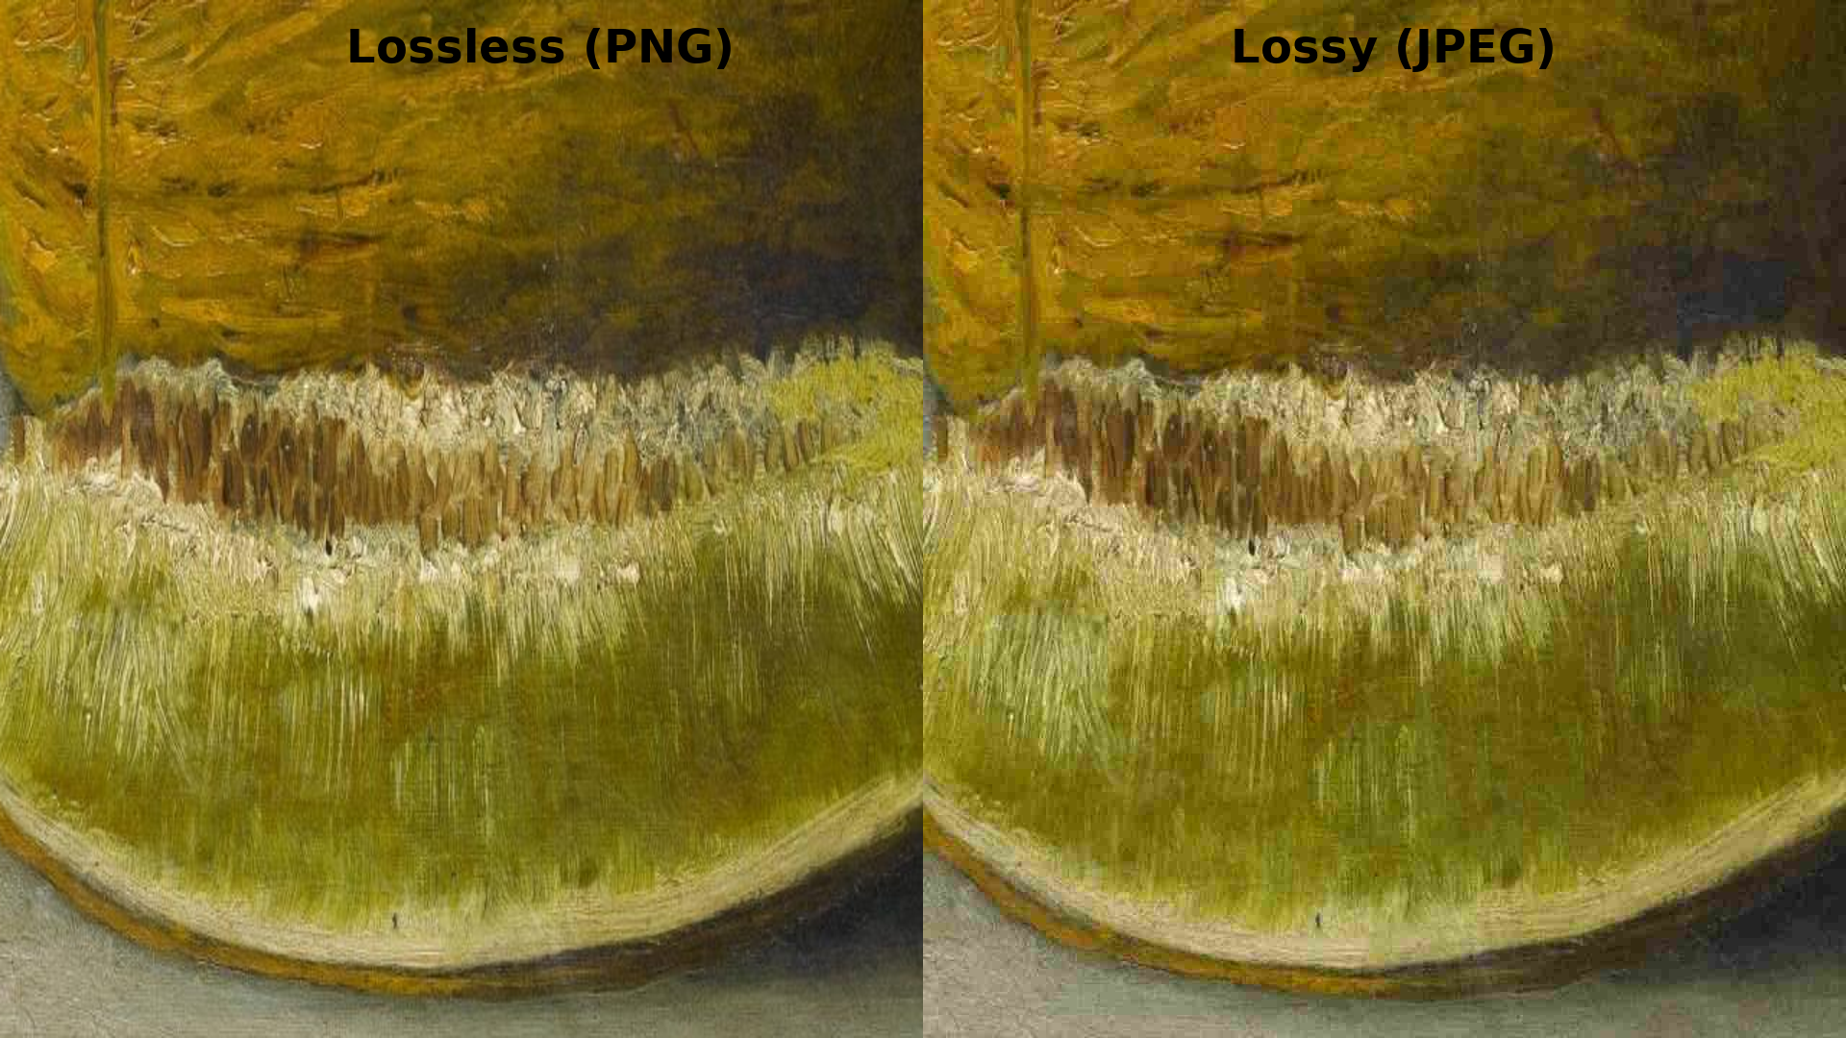
Compression
Types:
Lossy: Reduces quality for smaller size (e.g., JPEG).
Lossless: Preserves quality, larger files (e.g., PNG).
Trade-offs: Quality vs. file size vs. speed.
Key Takeaway: Choose compression based on needs.
Notes:
Explain JPEG algorithm with DCT, quantization, and entropy coding.

Slide 33
JPEG Algorithm
Steps:
DCT: Transform image to frequency domain.
Quantization: Reduce precision of frequencies.
Entropy Coding: Compress data (Huffman coding).
Result: Lossy, small files, visible artifacts at low quality.
Notes:
Explain PNG’s lossless DEFLATE compression and alpha transparency.

Slide 34
PNG Algorithm
Method: Lossless DEFLATE compression.
Features:
Supports alpha transparency (transparent backgrounds).
Preserves sharp edges, text, logos.
Key Takeaway: PNG = lossless with transparency.
Notes:
Highlight modern formats (WebP, AVIF) for efficient image storage.

Slide 35
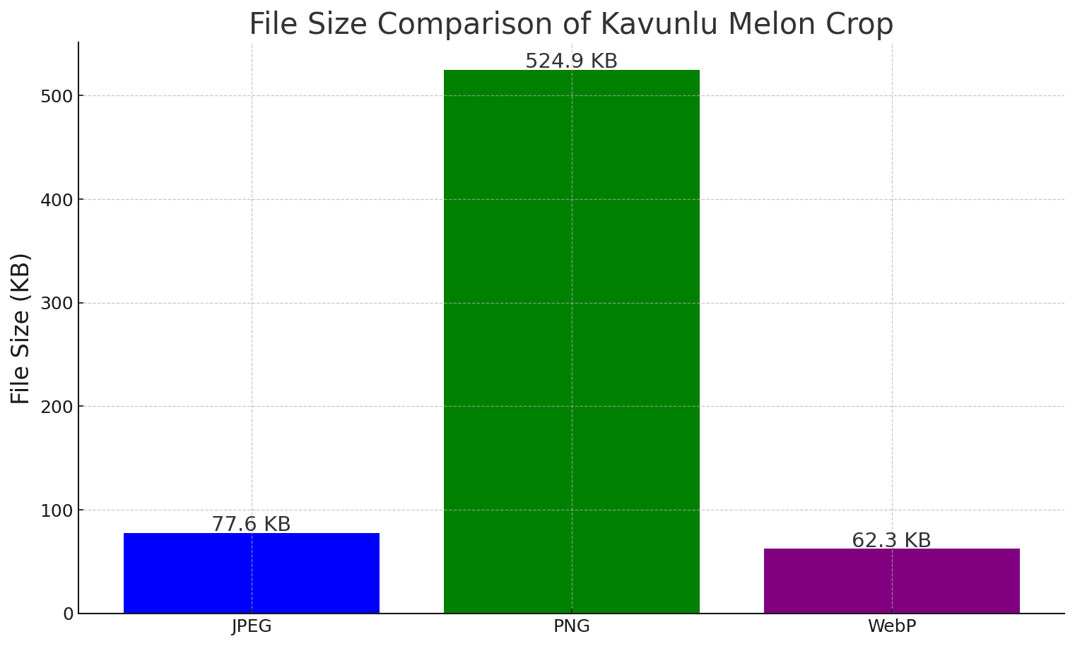
Modern Formats
WebP:
Lossy/lossless, smaller than JPEG/PNG.
Supports animation, transparency.
AVIF:
Advanced compression (HEVC-based).
Ideal for HDR, web delivery.
Use Case: Web graphics, mobile apps.
Notes:
Compare Kavunlu Natürmort as raster capturing textures vs vector capturing outlines.

Slide 36
Artistic Example
Raster:
Captures textures (e.g., melon’s rough surface).
Best for photorealistic details.
Vector:
Defines clean outlines (e.g., fruit shapes).
Ideal for scalable graphics.
Notes:
Introduce BMP format: simple, uncompressed, memory heavy.

Slide 37
BMP
Definition: Simple, uncompressed bitmap.
Features:
No compression—large file sizes.
Stores raw pixel data (RGB).
Use Case: Rarely used due to size; legacy systems.
Notes:
Introduce TIFF format: versatile, professional, supports multiple compressions.

Slide 38
TIFF
Definition: Versatile, professional format.
Features:
Supports multiple compression types (lossy/lossless).
Used in photography, archiving.
Drawback: Large files, less web-friendly.
Notes:
Introduce GIF format: 256 colors, simple animations, limited palette.

Slide 39
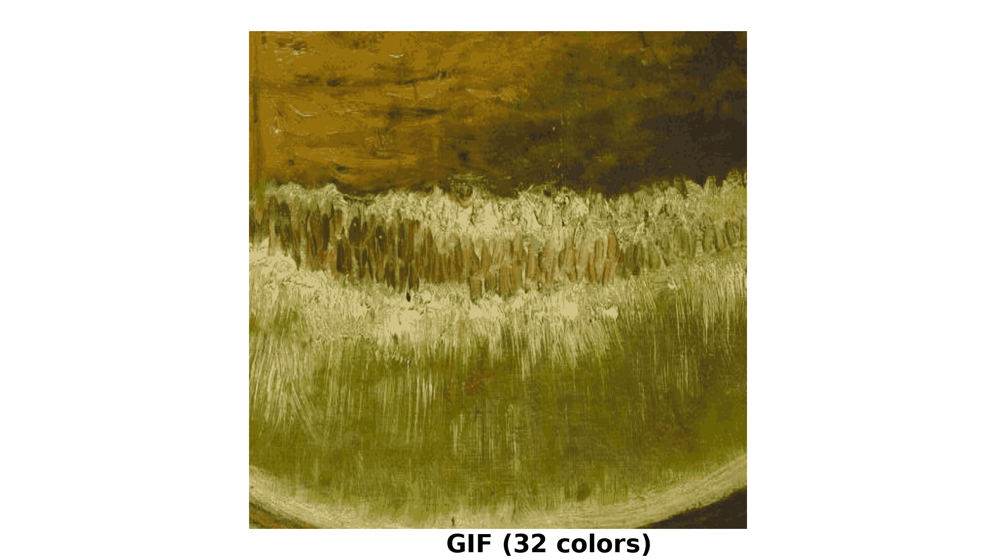
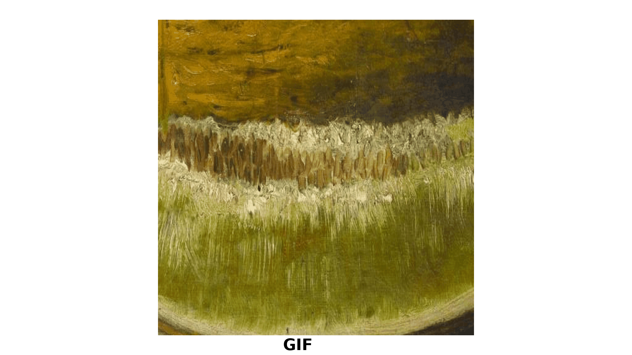
GIF
Definition: 256-color palette, supports animation.
Features:
Lossless LZW compression.
Limited colors = low quality for photos.
Use Case: Simple animations, memes.
Notes:
Explain JPEG macroblocks and quantization blocks in detail.

Slide 40
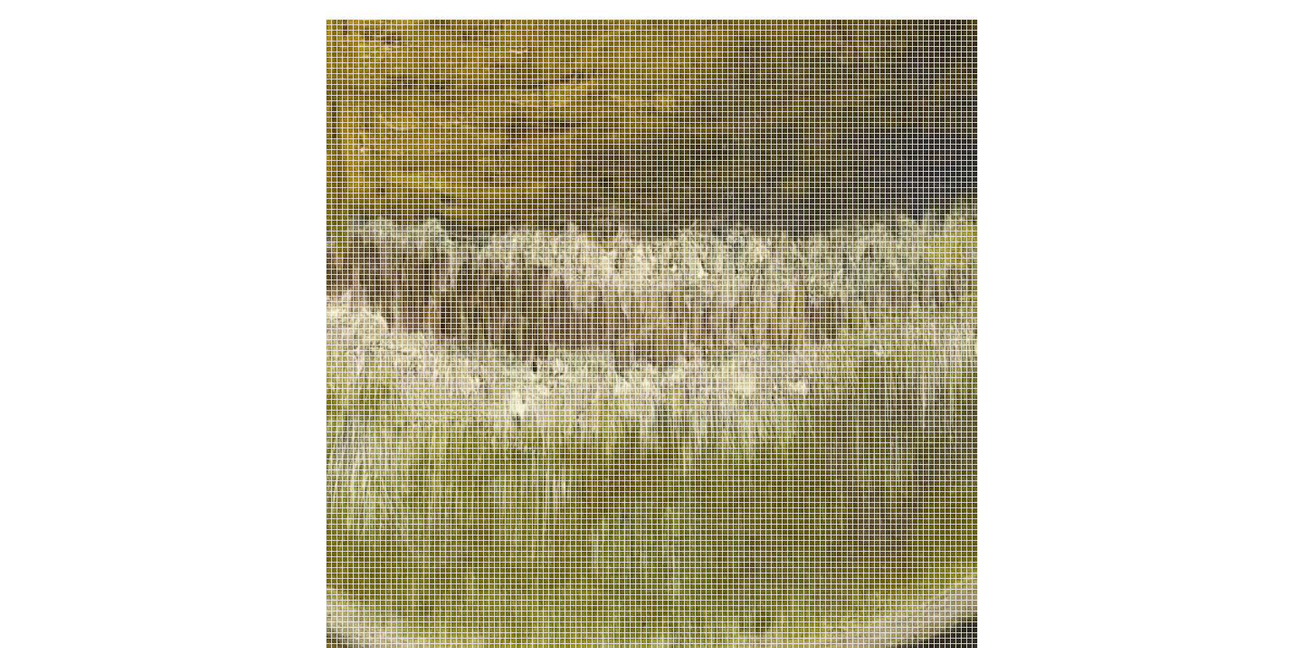
JPEG Deep Dive
Macroblocks: Image divided into 8x8 pixel blocks.
Process:
DCT: Convert to frequency domain.
Quantization: Reduce precision (causes artifacts).
Huffman Coding: Compress data.
Notes:
Show JPEG artifact examples: blocking, ringing, and mosquito noise.

Slide 41
JPEG Artifacts
Types:
Blocking: Visible 8x8 block edges.
Ringing: Halos around edges.
Mosquito Noise: Artifacts around sharp details.
Cause: Lossy quantization in JPEG.
Notes:
Explain PNG transparency and alpha blending equation.

Slide 42
PNG Transparency
Feature: Alpha channel for transparency.
Formula: C_out = αC_src + (1-α)C_dst
Use Case: Overlay objects.
Advantage: Perfect for web, logos, cutouts.
Notes:
Introduce SVG structure as XML tags describing geometry.

Slide 43
SVG Structure
Definition: XML-based format for vector graphics.
Structure:
Tags define shapes (e.g., `<circle>`, `<path>`).
Attributes set position, size, color.
Example: `<circle cx="50" cy="50" r="40" fill="red"/>`.
Use Case: Scalable icons, diagrams.
Notes:
Provide an SVG code example for rendering simple vector shapes.

Slide 44
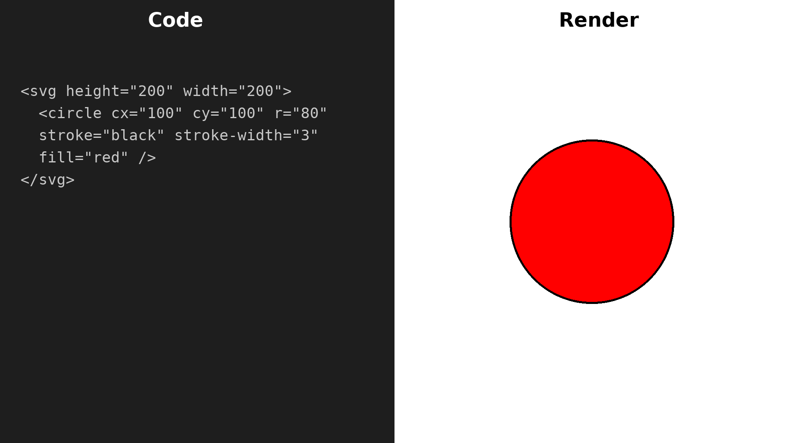
SVG Example Code
Demo: Scale circle in browser—no pixelation!
Notes:
Discuss vector operations: scaling and rotation applied to primitives.

Slide 45
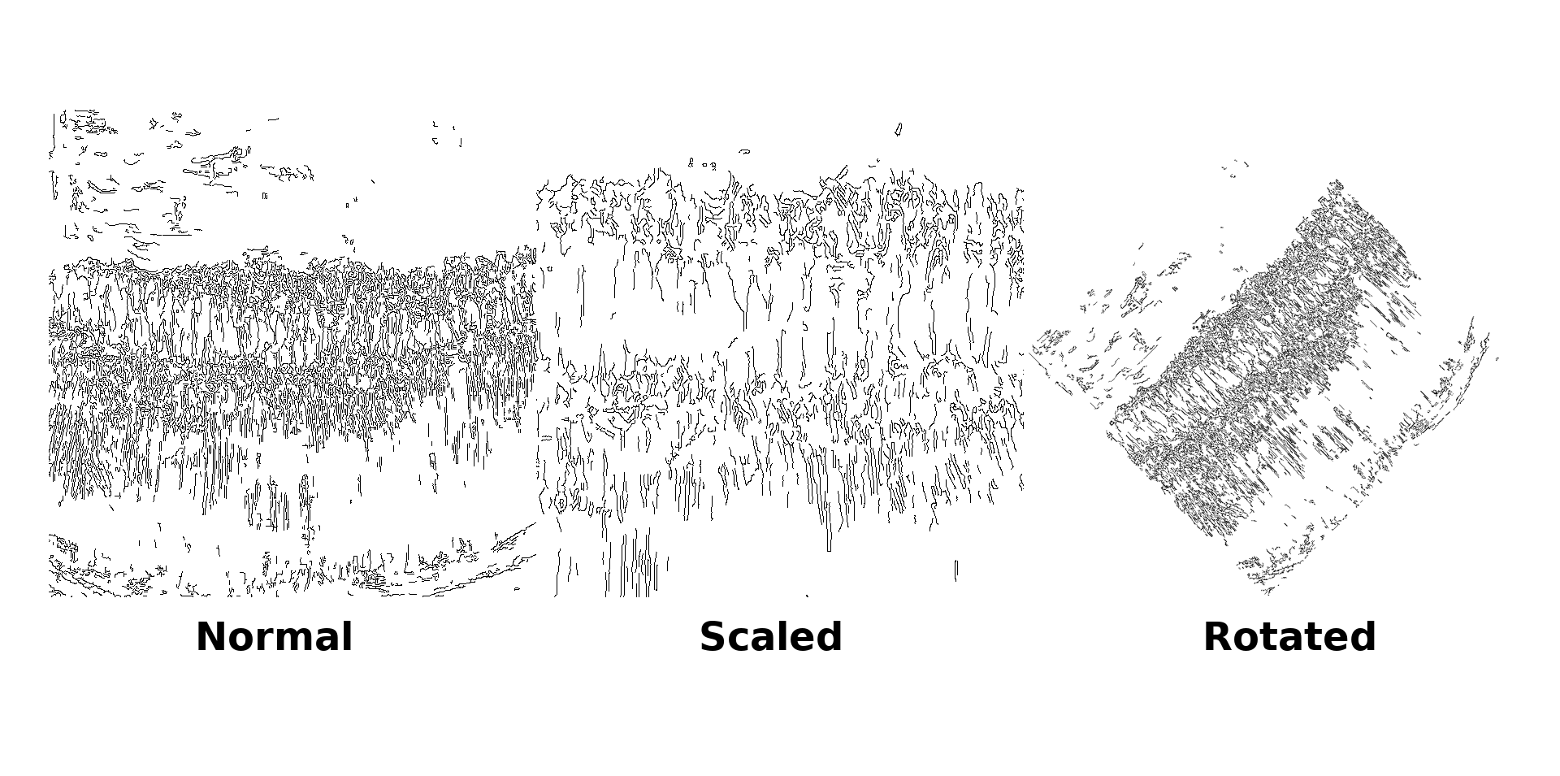
Vector Operations
Operations:
Scaling: Resize shapes mathematically.
Rotation: Rotate around a point.
Translation: Move shapes in 2D space.
Advantage: No quality loss, GPU-friendly.
Use Case: Logos, 3D modeling.
Notes:
Explain rasterization: converting mathematical shapes to pixel grids.

Slide 46
Rasterization of Vectors
Definition: Converting vectors to pixel grids.
Process:
GPU maps lines/curves to pixels.
May introduce aliasing (jaggies).
Use Case: Display vectors on screens.
Key Takeaway: Rasterization bridges vector to raster.
Notes:
Introduce histograms as tools for analyzing brightness distribution.

Slide 47
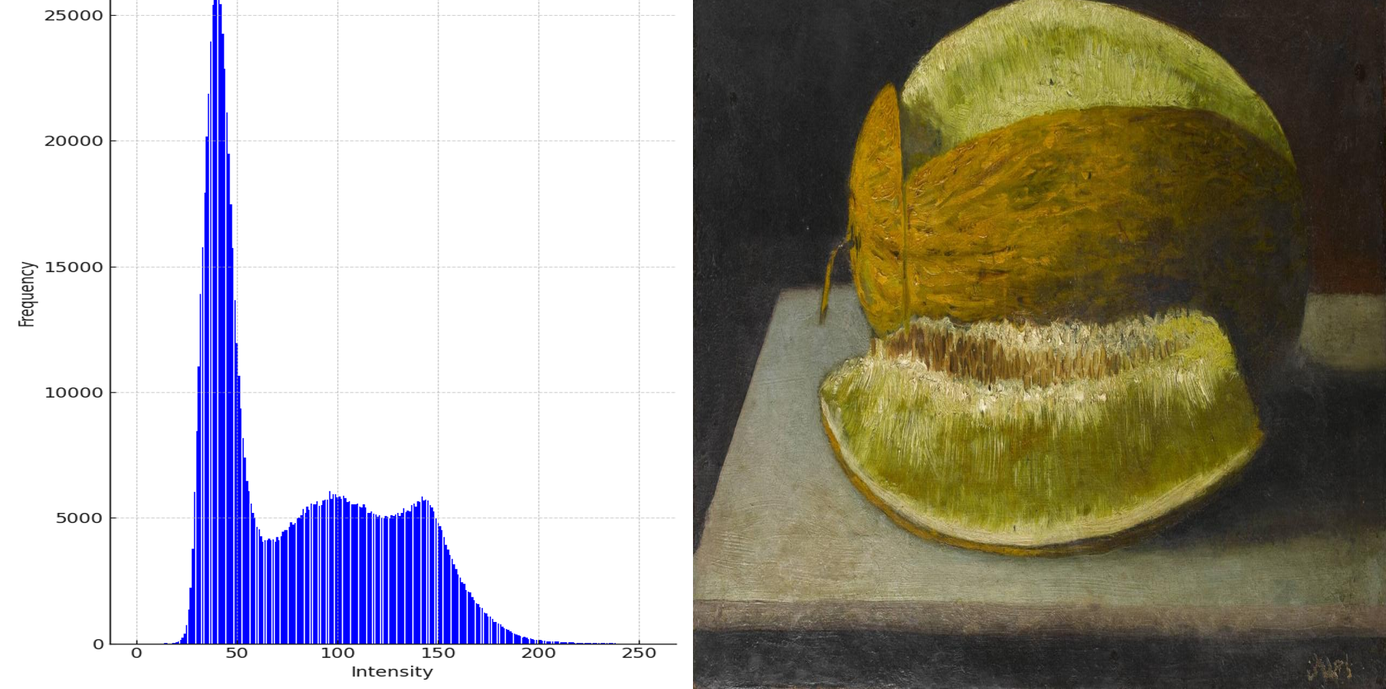
Image Histograms
1. What is a histogram in an image?
A histogram is a graph that counts how many pixels are dark, medium, or bright in the picture.
On this graph:
The left side means dark (black).
The right side means bright (white).
The middle is all the gray shades in between.
2. What does the
Kavunlu Natürmort
histogram show?
The left side of the graph is high → this means the painting has a lot of dark pixels (background is almost black).
The middle has some pixels → this is the melon’s yellow and green tones.
The right side is lower → there are not many very bright spots, because the painting is dark and muted overall.
3. Why is this useful?
It tells us the brightness balance of an image.
A painting like Kavunlu has a dark background and medium tones in the fruit, so the histogram looks heavy on the left side.
A sunny beach photo would show the opposite — lots of bright pixels on the right side.
Definition: Graph of pixel brightness distribution.
Use Case:
Adjust contrast/brightness.
Example: Histogram of painting’s fruit (bright vs. dark areas).
Tool: Useful for image correction in editing.
Notes:
Introduce convolution filtering and its mathematical formulation.

Slide 48
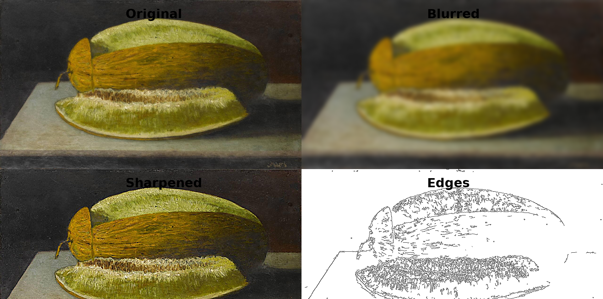
Image Filtering
Definition: Apply convolution to modify pixels.
Formula: Output = Sum(Kernel × Neighborhood).
Types:
Blur: Smooth images.
Edge Detection: Highlight boundaries.
Sharpening: Enhance details.
Notes:
Explain Gaussian blur kernel with weighted averaging.

Slide 49
Blur Filter
Gaussian Blur:
Uses weighted kernel (e.g., 3x3 or 5x5).
Smooths images by averaging pixels.
- Kernel Example:
[1/16 2/16 1/16]
[2/16 4/16 2/16]
[1/16 2/16 1/16]
Use Case: Reduce noise, create soft effects.
Notes:
Explain edge detection using Sobel operator kernels.

Slide 50
Edge Detection
Sobel Operator:
Detects edges using horizontal/vertical kernels.
Kernel Example:
Gx = [-1 0 1] Gy = [-1 -2 -1]
[-2 0 2] [ 0 0 0]
[-1 0 1] [ 1 2 1]
Use Case: Geometry extraction (Project 1).
Notes:
Introduce sharpening filters through high-pass kernels.

Slide 51
Sharpening
High-Pass Filter:
Enhances edges by amplifying differences.
Kernel Example:
[ 0 -1 0]
[-1 5 -1]
[ 0 -1 0]
Use Case: Improve clarity in images.
Notes:
Explain noise types in images and their origins.

Slide 52
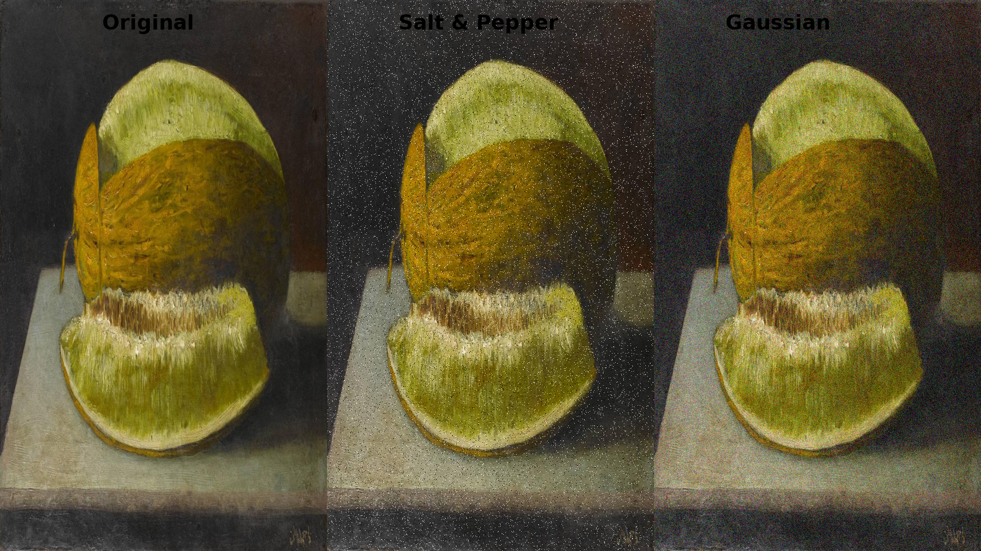
Noise in Images
Types:
Salt-and-Pepper: Random bright/dark pixels.
Gaussian: Random variations in intensity.
Sources: Sensor errors, low light, compression.
Impact: Degrades visual quality.
Notes:
Introduce denoising with median and bilateral filtering.

Slide 53
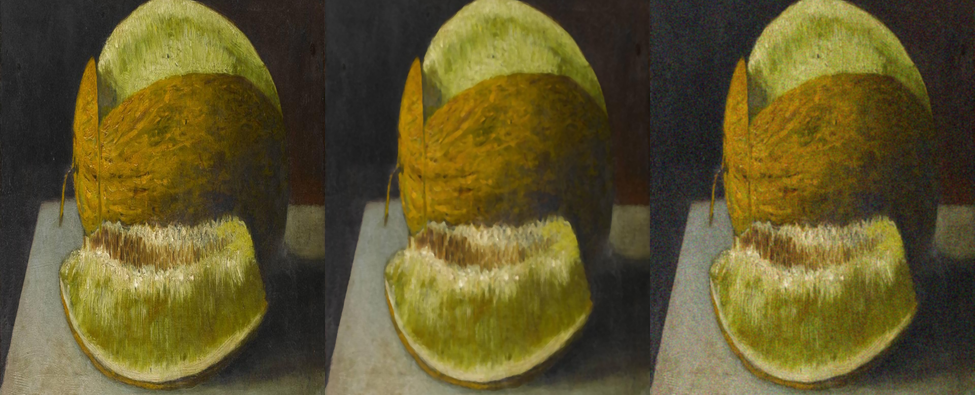
Denoising
Techniques:
Median Filter: Replaces pixel with neighborhood median.
Bilateral Filter: Preserves edges while smoothing.
Use Case: Clean scans for Project 1 analysis.
Key Takeaway: Denoising improves clarity.
Notes:
Introduce Fourier transform as frequency domain analysis tool.

Slide 54
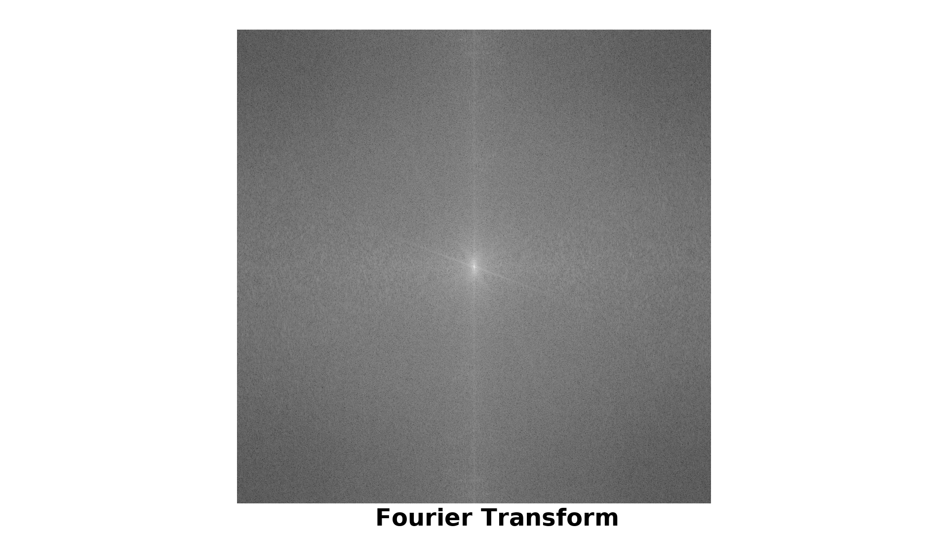
Frequency Domain
Fourier Transform:
Converts image to frequency components.
Low frequencies = smooth areas, high = edges.
It shows the grayscale Fourier spectrum of the entire painting, with bright spots representing edges and frequencies
Application: Filtering, compression, analysis.
Key Takeaway: Frequency = image structure.
• Kavunlu Natürmort has a dark background → strong low frequencies → big bright center.
• The edges of the melon and fruits create high frequency components → the small bright spots farther out.
• If the painting had lots of fine texture (like fabric or grass), you’d see even more energy in the outer areas.
Notes:
Show FFT applied to an image to reveal frequency components.

Slide 55
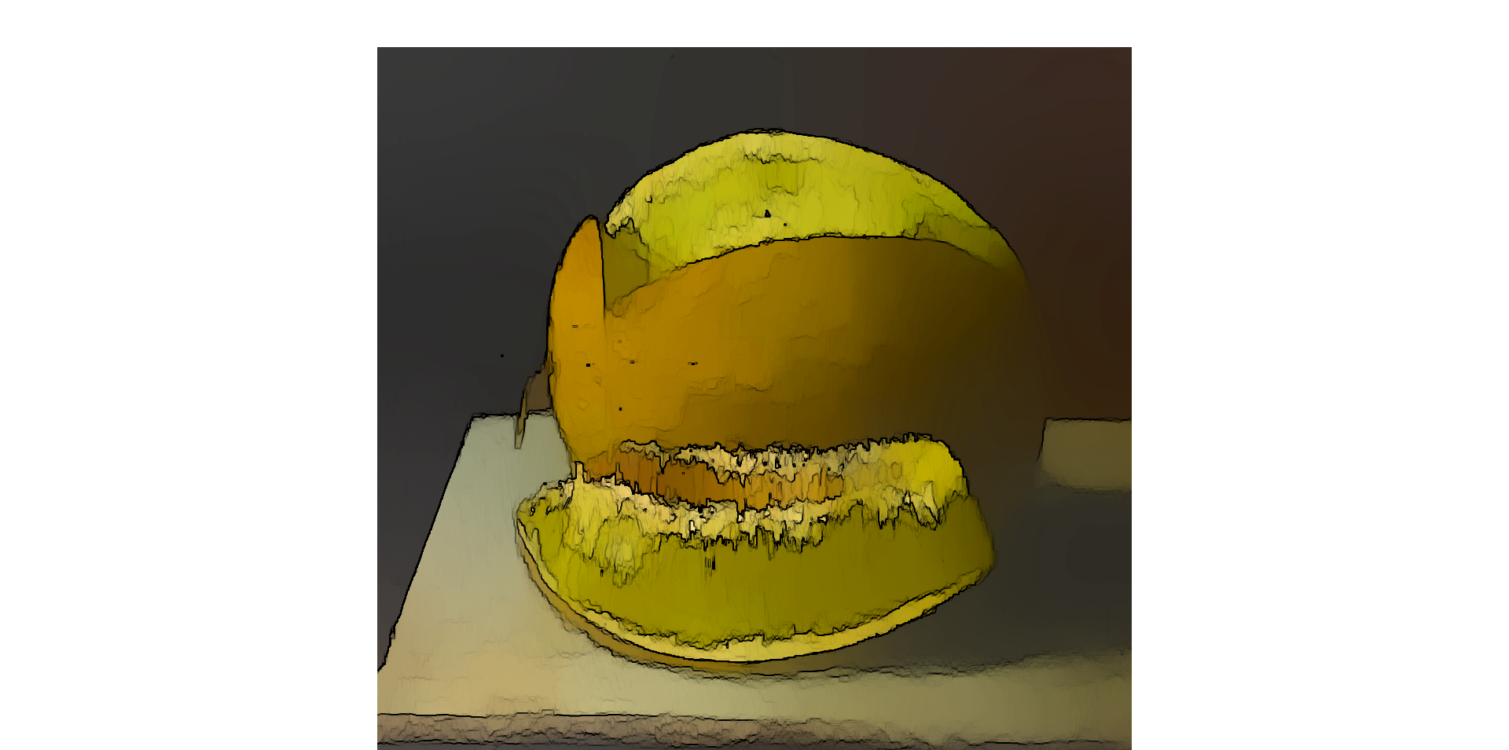
Artistic Link
Filters (blur, edge detection) mimic artistic brushstrokes.
Application: NPR shaders (Project 2) inspired by art.
Key Takeaway: Graphics enhances art!
Notes:
Explain transition from static images to dynamic graphics pipelines.

Slide 56
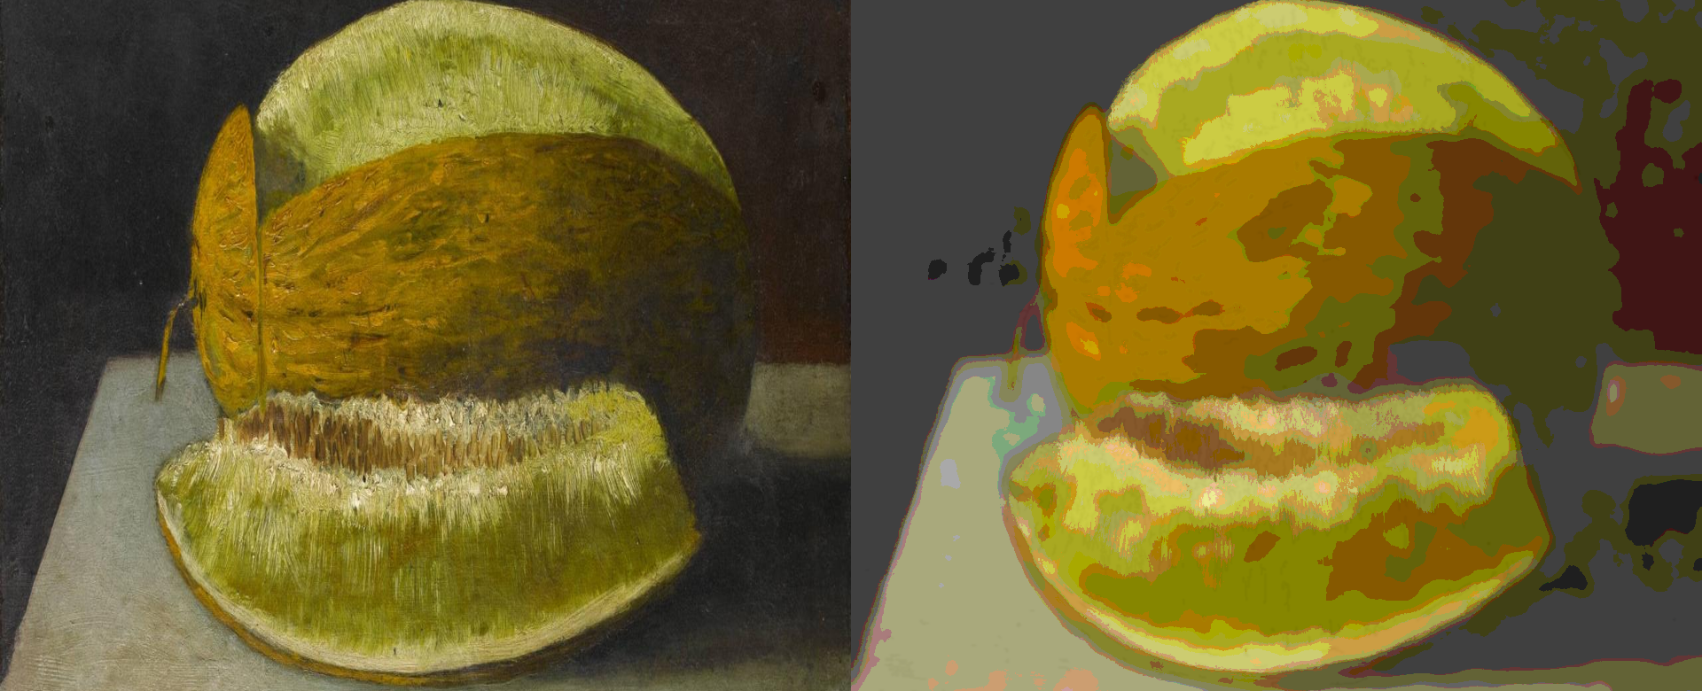
From Images to Graphics
Transition:
Static images → dynamic rendering pipelines.
From 2D pixels to 3D scenes.
Tools: WebGL, WebGPU for real-time graphics.
Key Takeaway: Images evolve into interactive graphics.
Notes:
Compare HTML Canvas for 2D vs WebGL for GPU-accelerated 3D rendering.

Slide 57
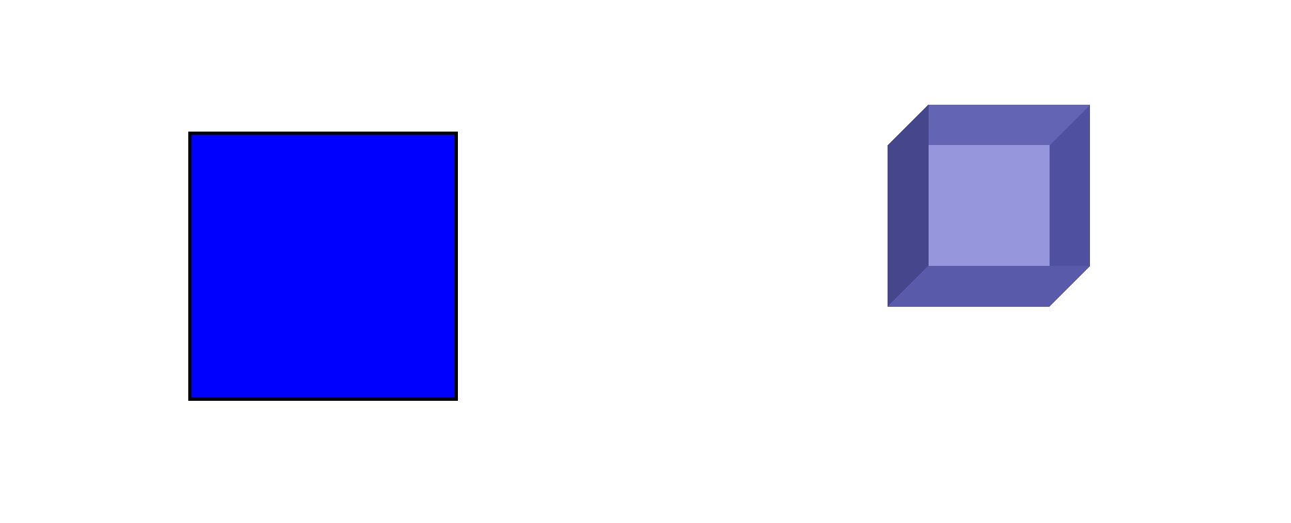
Canvas vs WebGL
HTML Canvas:
2D drawing API, CPU-based.
Good for simple graphics (e.g., charts).
WebGL:
GPU-accelerated 3D rendering.
Ideal for complex scenes, shaders.
Key Takeaway: WebGL = power for 3D.
Notes:
Show how to set up a WebGL rendering context in JavaScript.

Slide 58
Setting Up WebGL
Steps:
Create `<canvas>` in HTML.
Get WebGL context: `canvas.getContext('webgl')`.
Set up shaders, buffers, viewport.
Test: https://get.webgl.org/ (browser support).
Example: Render a triangle (next slide!).
Tip: Use VS Code, test in Chrome.
Notes:
Demonstrate Hello Triangle program and its significance.

Slide 59
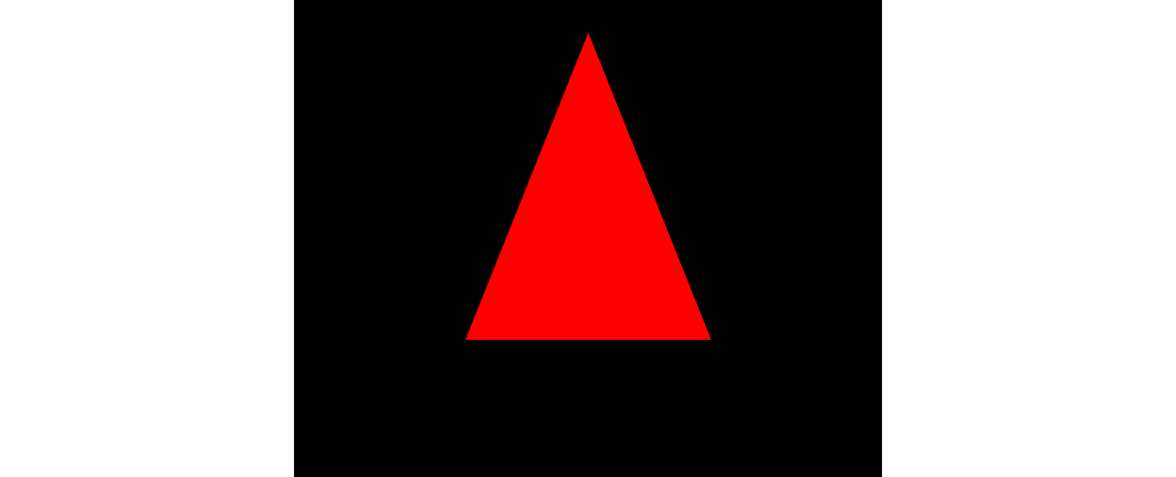
Drawing Triangle
Drawing Triangle: Hello Triangle
Significance: Simplest WebGL program.
Steps:
Define vertices in a buffer.
Write vertex/fragment shaders.
Render triangle to canvas.
Example: Red triangle in WebGL.
Notes:
Explain vertex buffers as GPU storage for geometry data.

Slide 60
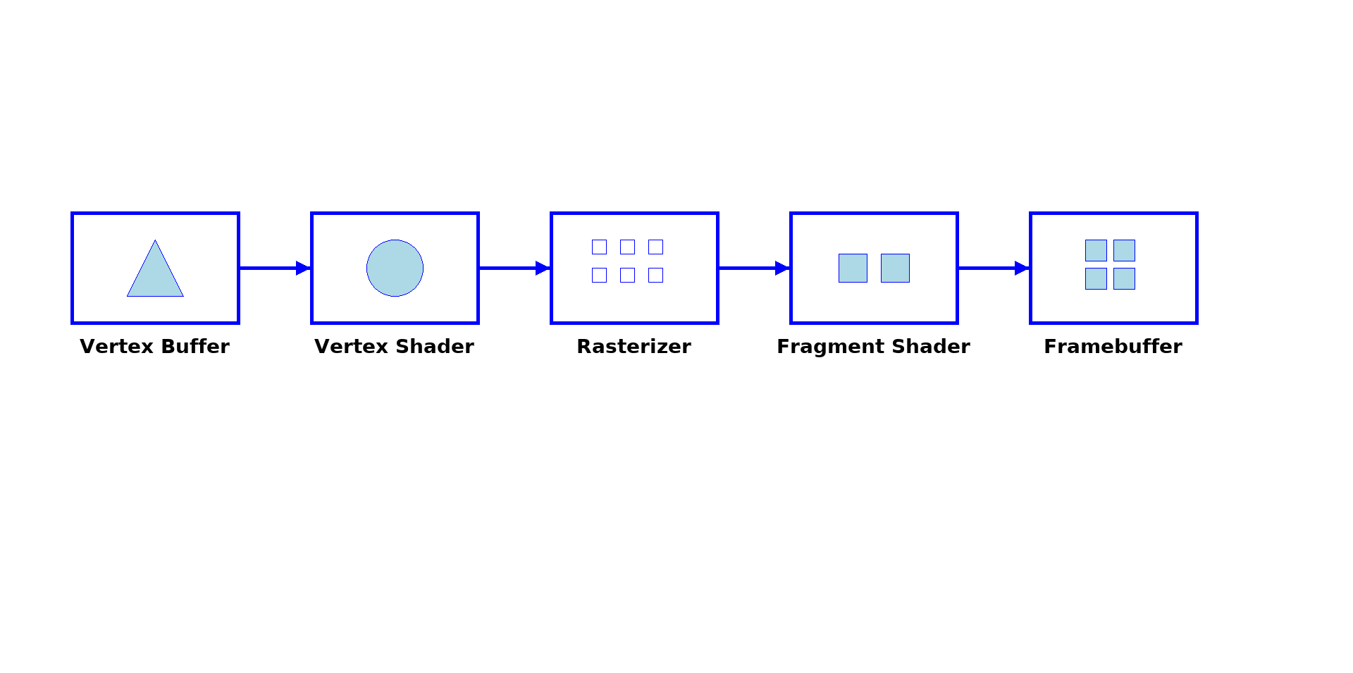
Vertex Buffers
Definition: GPU storage for geometry (e.g., triangle vertices).
Process:
Create buffer: `gl.createBuffer()`.
Load vertex data (x, y, z coordinates).
Use Case: Efficient geometry rendering.
Notes:
Explain fragment shaders as per-pixel programs for final color.

Slide 61
Fragment Shader
Definition: Per-pixel program for color/texture.
Example:
Glsl
precision mediump float;
void main() { gl_FragColor = vec4(1.0, 0.0, 0.0, 1.0); // Red
}
Key Takeaway: Shaders define visual output.
Notes:
Compare shading languages GLSL and WGSL, with future outlook.

Slide 62
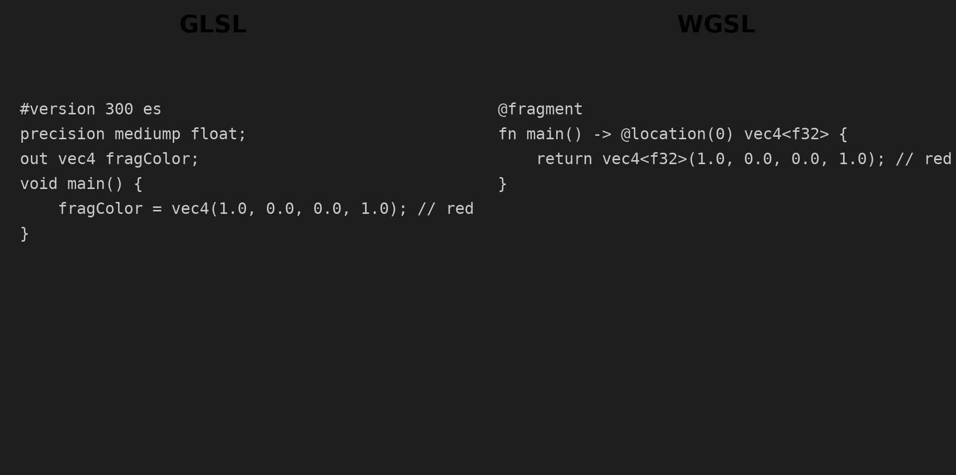
Shading Languages
GLSL (OpenGL Shading Language):
Used in WebGL, mature, widely supported.
WGSL (WebGPU Shading Language):
Next-gen, designed for WebGPU.
Simpler syntax, future-proof.
Example: Red triangle in GLSL vs. WGSL.
Notes:
Provide minimal GLSL shader example (vertex and fragment).

Slide 63
GLSL Example
Vertex Shader:
glsl
attribute vec2 a_position;
void main() {
gl_Position = vec4(a_position, 0.0, 1.0);
}
```
- Fragment Shader:
```glsl
precision mediump float;
void main() {
gl_FragColor = vec4(1.0, 0.0, 0.0, 1.0); // Red
}
```
Result: Renders a red triangle.
SSM Link: Basis for Project 2 shaders.
Notes:
Introduce debugging tools like Spector.js for WebGL inspection.

Slide 64
WebGL Debugging
Tool: Spector.js (browser extension).
Features:
Inspect WebGL calls, shaders, buffers.
Debug rendering issues (e.g., black screen).
Notes:
Compare GPU and CPU: parallelism and SIMD architectures.

Slide 65
Framebuffer
Definition: GPU memory for rendered image.
Role: Stores pixel colors before display.
Use Case: WebGL renders to framebuffer.
Key Takeaway: Framebuffer = render target.
Notes:
Introduce z-buffer and depth testing for visibility resolution.

Slide 66
Z-buffer
Definition: Depth buffer for visibility.
Algorithm:
Stores depth (z-value) per pixel.
Resolves which objects are in front.
Use Case: Prevents hidden surfaces in rendering.
Notes:
Explain rendering loop using requestAnimationFrame.

Slide 67
Rendering Loop
Method: `requestAnimationFrame` for smooth rendering.
Steps:
Update scene (e.g., rotate objects).
Render to framebuffer.
Repeat per frame (60 FPS).
Use Case: Real-time graphics (games, apps).
Notes:
Show how user interaction drives real-time rendering (mouse, keyboard).

Slide 68
Real-Time Interaction
Inputs:
Mouse: Rotate, zoom scenes.
Keyboard: Move objects, toggle effects.
Code: `canvas.addEventListener('mousemove', handleMouse)`.
Use Case: Games, VR, interactive apps.
Notes:
Demonstrate rotating cube with basic texture mapping.

Slide 69
Demo
Demo: Rotating Cube
Setup:
WebGL canvas with textured cube.
Basic vertex/fragment shaders.
Features:
Rotate cube with mouse/keyboard.
Goal: Preview Project 3 interactivity.
Notes:
Summarize Week 1 topics: raster vs vector, image formats, compression.

Slide 70
Week 1 Summary
Key Concepts:
Raster: Pixel grids, textures (e.g., JPEG, PNG).
Vector: Scalable shapes (e.g., SVG).
Image formats: Compression, artifacts, transparency.
Intro to WebGL: Triangles, shaders, rendering.
Takeaway: Images are the foundation of graphics!
Notes:
Recap key formulas: gamma correction, convolution, alpha blending.

Slide 71
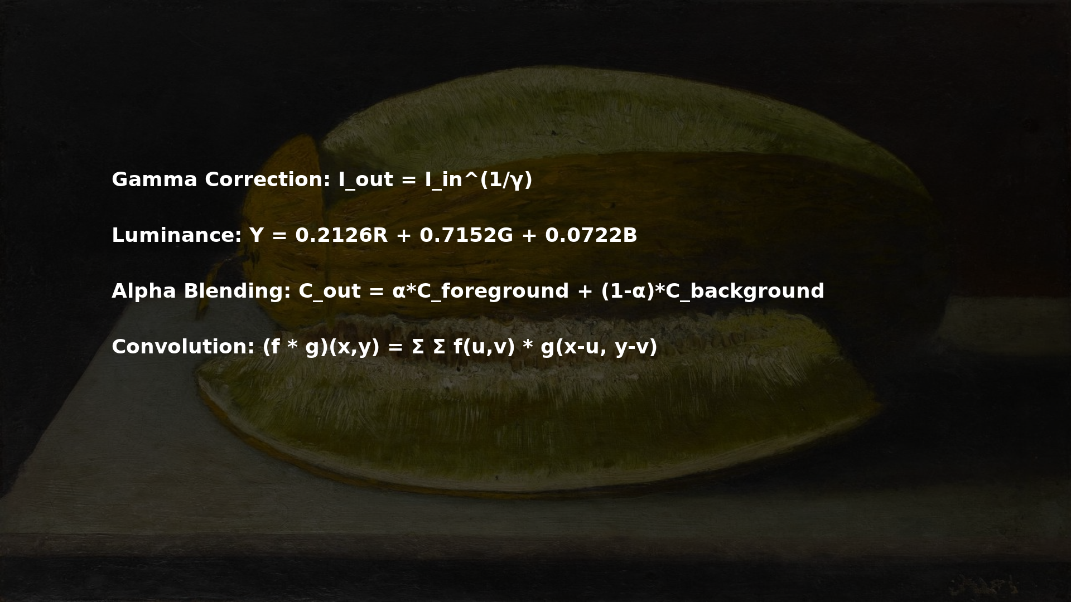
Formulas Recap
Notes:
Compare raster vs vector in context of Kavunlu Natürmort painting.

Slide 72
Art & Graphics
Art & Graphics:
Raster:
Captures textures (e.g., melon’s surface).
Ideal for photorealistic rendering.
Vector:
Defines clean outlines (e.g., fruit shapes).
Perfect for scalable designs.
Connection: Art inspires graphics algorithms (Projects 1-3).
Notes:
Connect Project 1’s geometry extraction to raster image processing.

Slide 73
Link to Project 1
Goal: Extract lines, curves from paintings.
Techniques:
Hough Transform: Detect straight lines.
Bézier Curves: Fit organic shapes.
Vanishing Points: Perspective correction.
Release: Week 3, submit Week 6.
Notes:
List industry applications of graphics: VR, games, CAD, film pipelines.

Slide 74
Industry Applications
Industry Applications
Fields:
Games: Unreal Engine, Unity.
Film: Pixar, VFX pipelines.
CAD: Architecture, engineering.
VR/AR: Immersive experiences.
Impact: Graphics drives $100B+ industries!
Notes:
Show cutting-edge neural compression approaches for images.

Slide 75
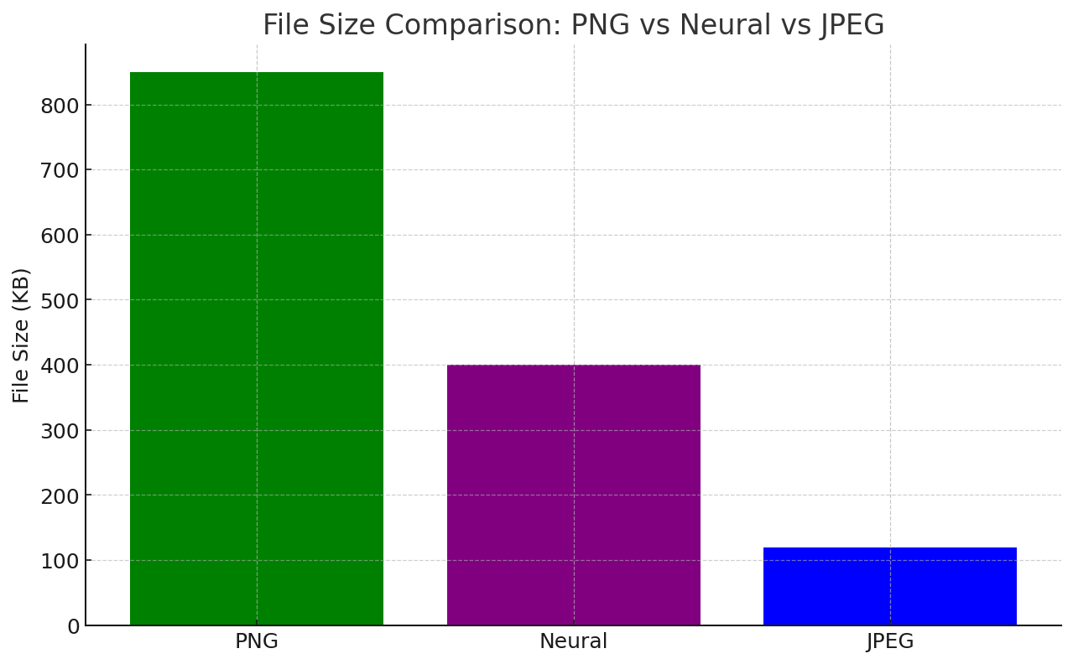
Cutting Edge
Cutting Edge: Neural Compression
Advances:
Neural codecs: Compress images using AI.
Example: Stable Diffusion for image generation.
Impact: Smaller files, higher quality.
Future: AI-driven graphics pipelines.
Notes:
Highlight SIGGRAPH research showcasing compression and imaging.

Slide 76

SIGGRAPH Highlights
SIGGRAPH: Top conference for graphics research.
Recent Topics:
Neural rendering: AI-generated scenes.
Real-time ray tracing: NVIDIA RTX.
Compression: Neural codecs, AVIF.
Resource: SIGGRAPH papers online.
Notes:
Interactive student activity: analyze pros/cons of image formats.

Slide 77
Student Activity
Task: Analyze pros/cons of image formats.
Pick one: JPEG, PNG, WebP, SVG.
Compare: Quality, size, use case.
Goal: Understand format trade-offs.
Notes:
Quiz questions reviewing raster, vector, gamma correction.

Slide 78
Quiz
Quiz: Week 1 Review
- Sample Questions:
- What’s the difference between raster and vector images?
- Why does JPEG show artifacts when zoomed?
- What’s the formula for gamma correction?
- How does WebGL differ from Canvas?
- Format: Multiple choice, submit on SuCourse.
Notes:
Preview Week 2: linear algebra foundations for computer graphics.

Slide 79
Preview Week 2
Preview Week 2: Linear Algebra Foundations
Topics:
Vectors, matrices, transformations.
2D graphics basics.
SSM Painting: Feyhaman Duran – Kabataş Rıhtımı.
Goals:
Understand math behind graphics.
Prepare for Project 1 geometry.

